Slide 1
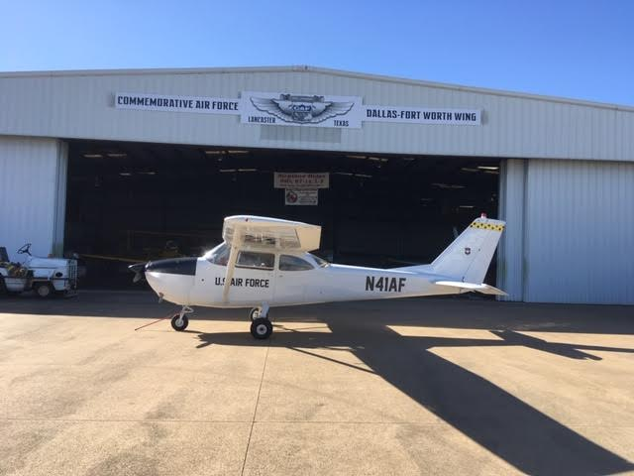
T41A walk around

Slide 2
Airworthiness and Registration

Slide 3
Operating Manual

Slide 4
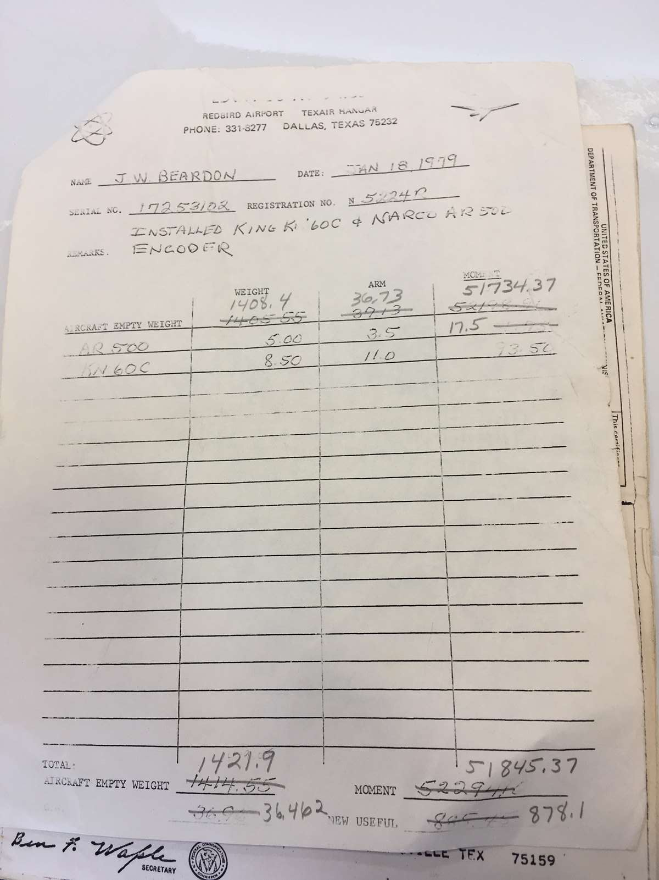
Weight and Balance

Slide 5
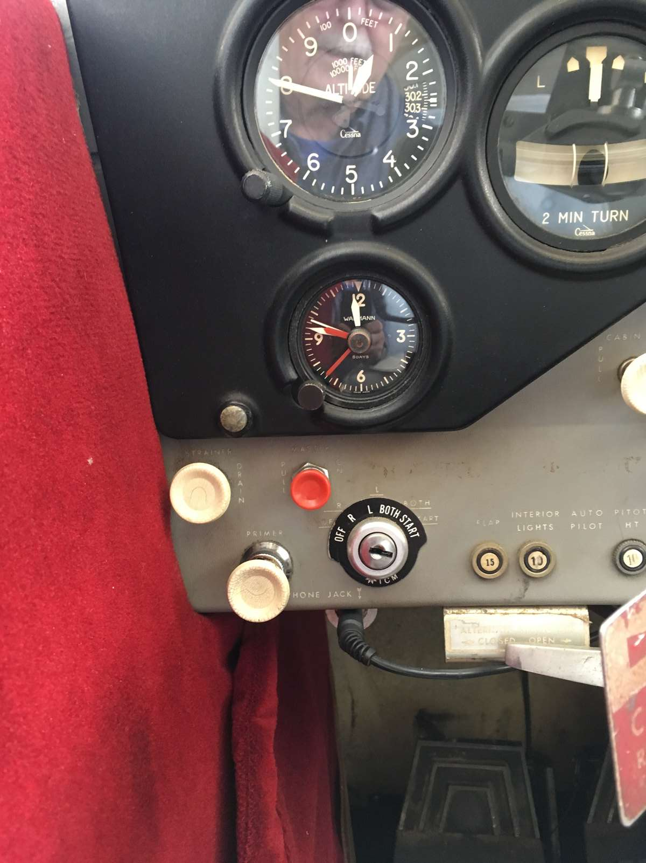
Master and mags

Slide 6
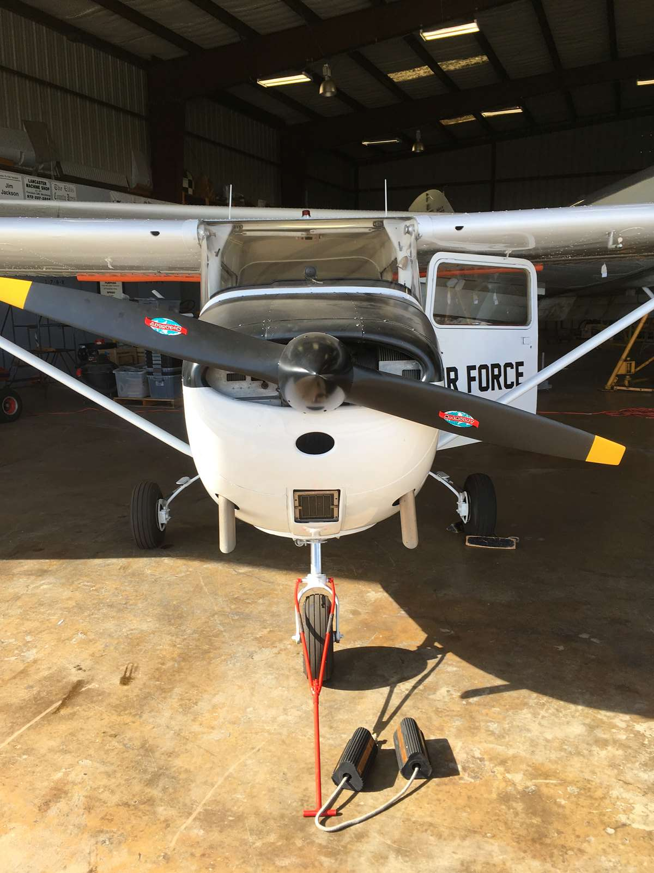
Propeller Air intake

Slide 7
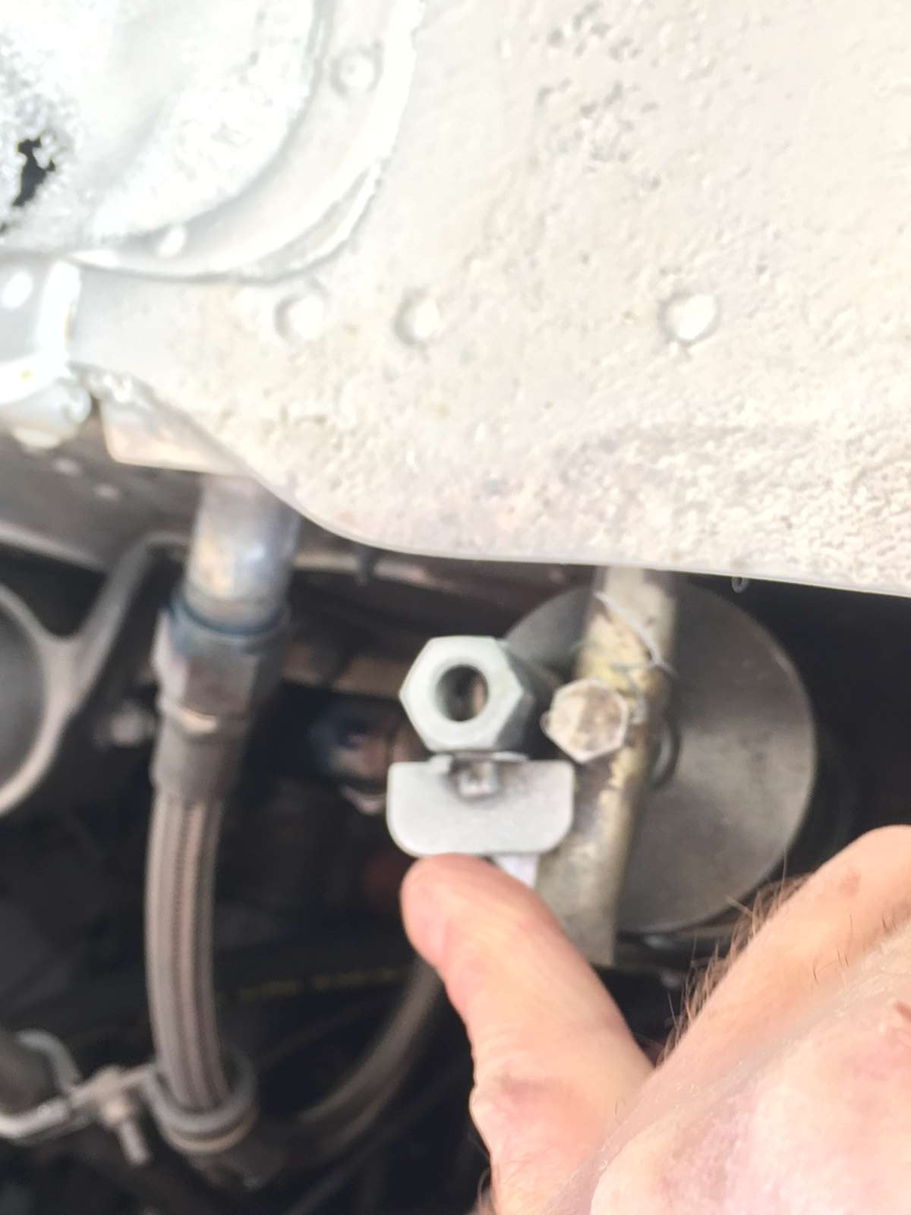
Lower fuel sump

Slide 8
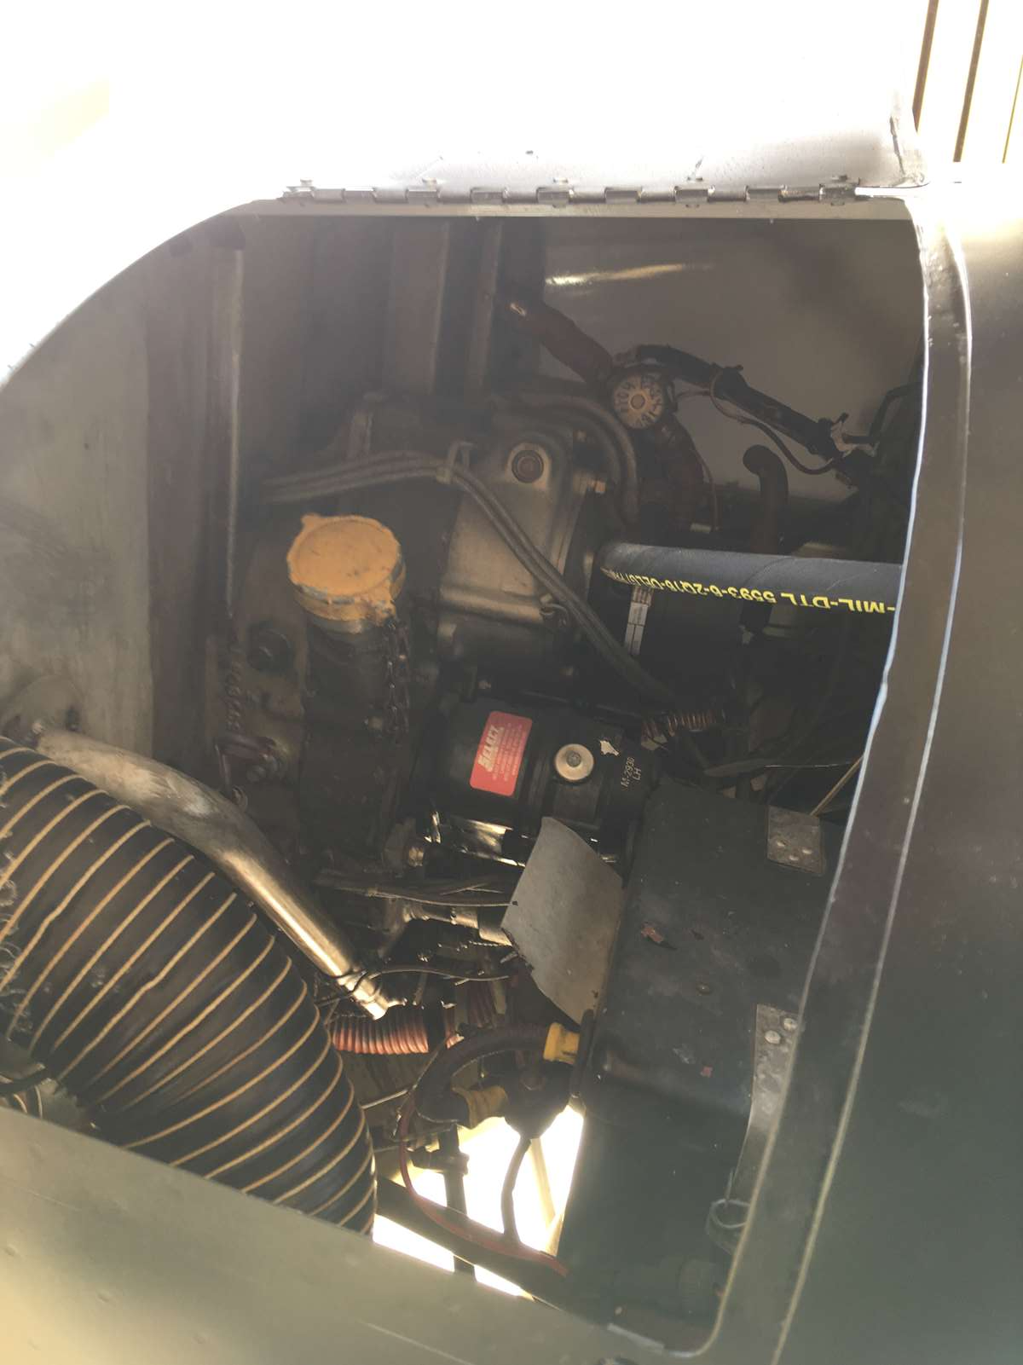
Oil dip stick

Slide 9
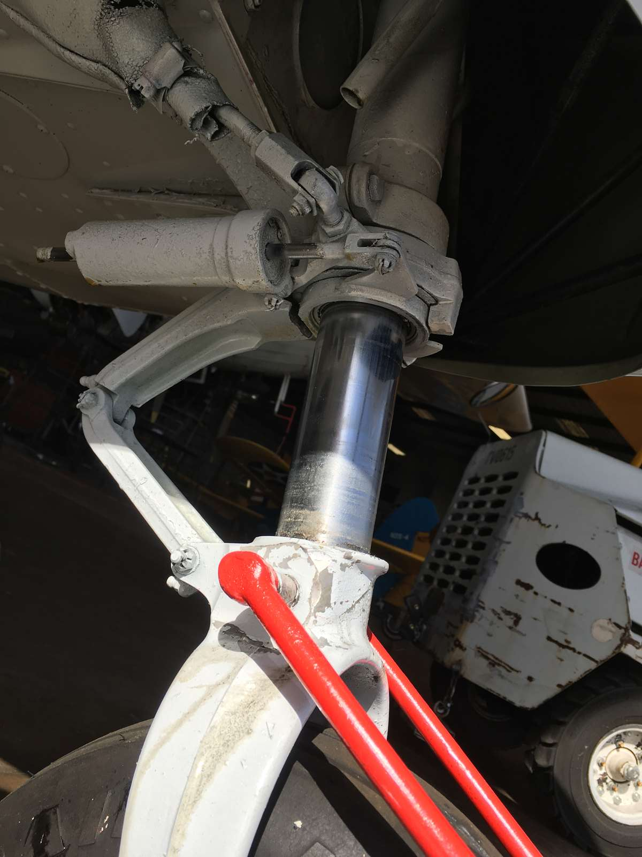
Strut extension

Slide 10
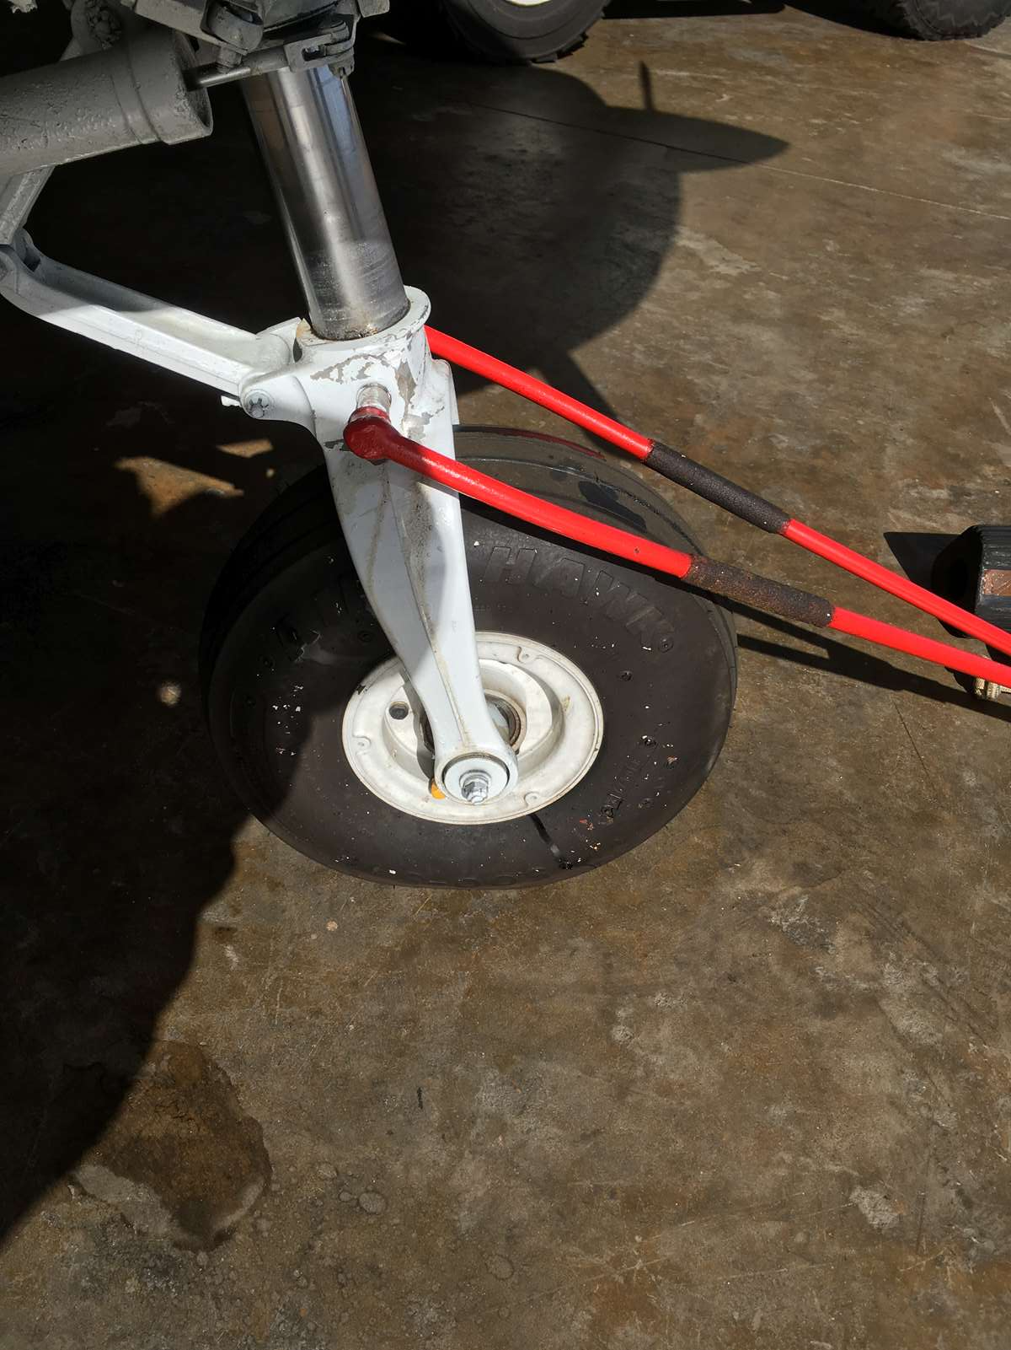
Nose Tire inflation Tire inflation

Slide 11
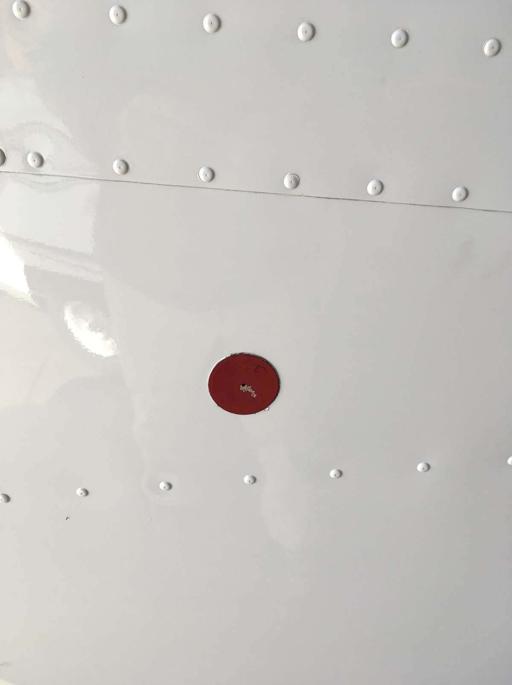
Static port

Slide 12
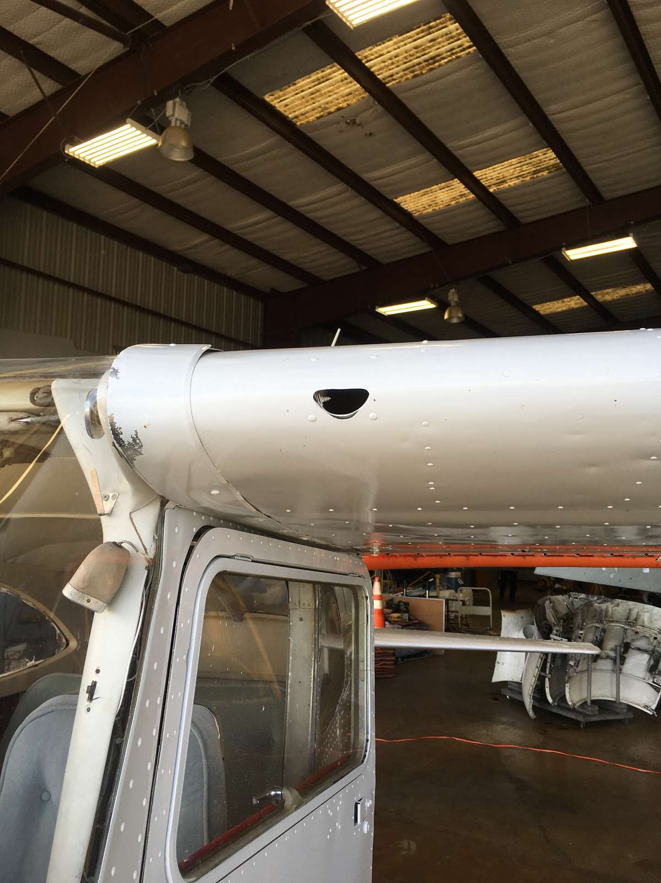
Cabin air vent

Slide 13
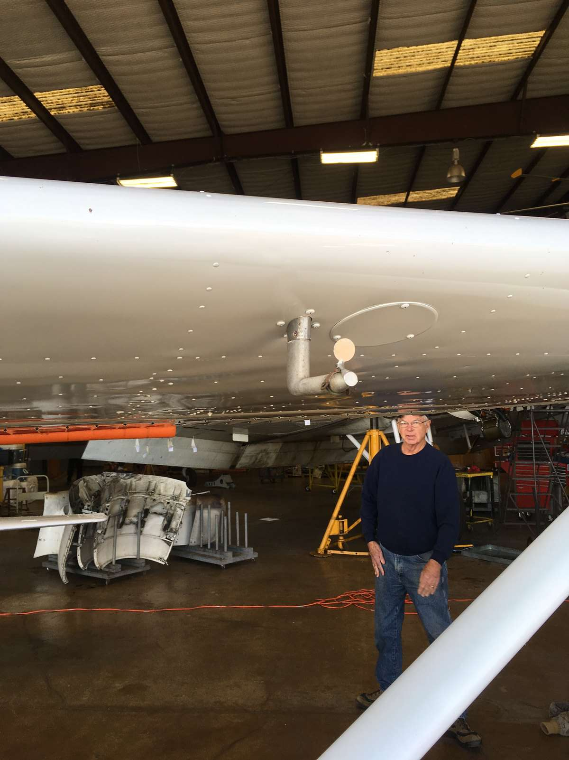
Pitot tube

Slide 14
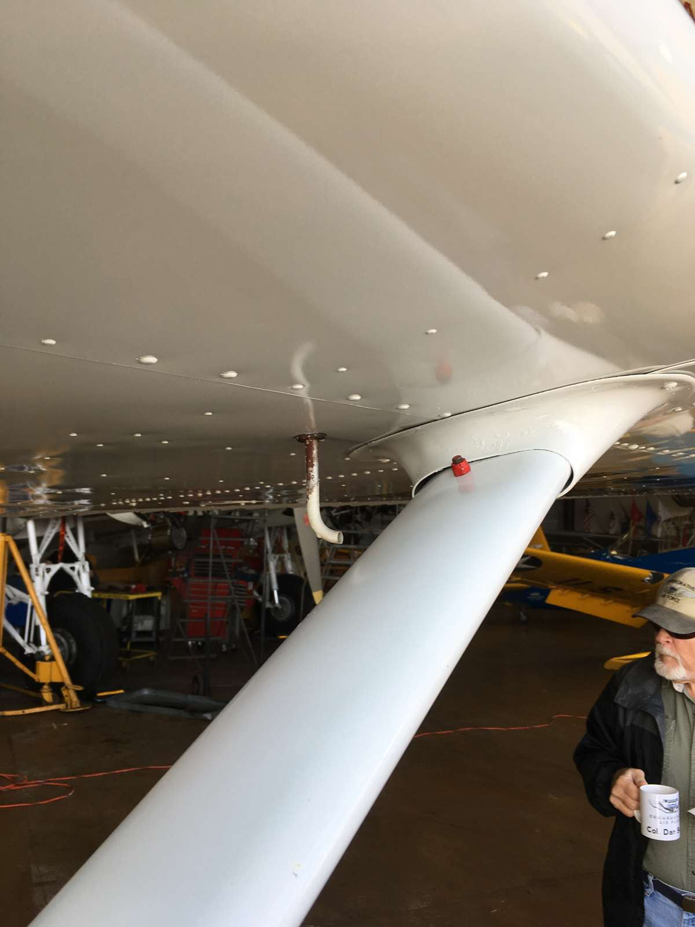
Fuel tank vent

Slide 15
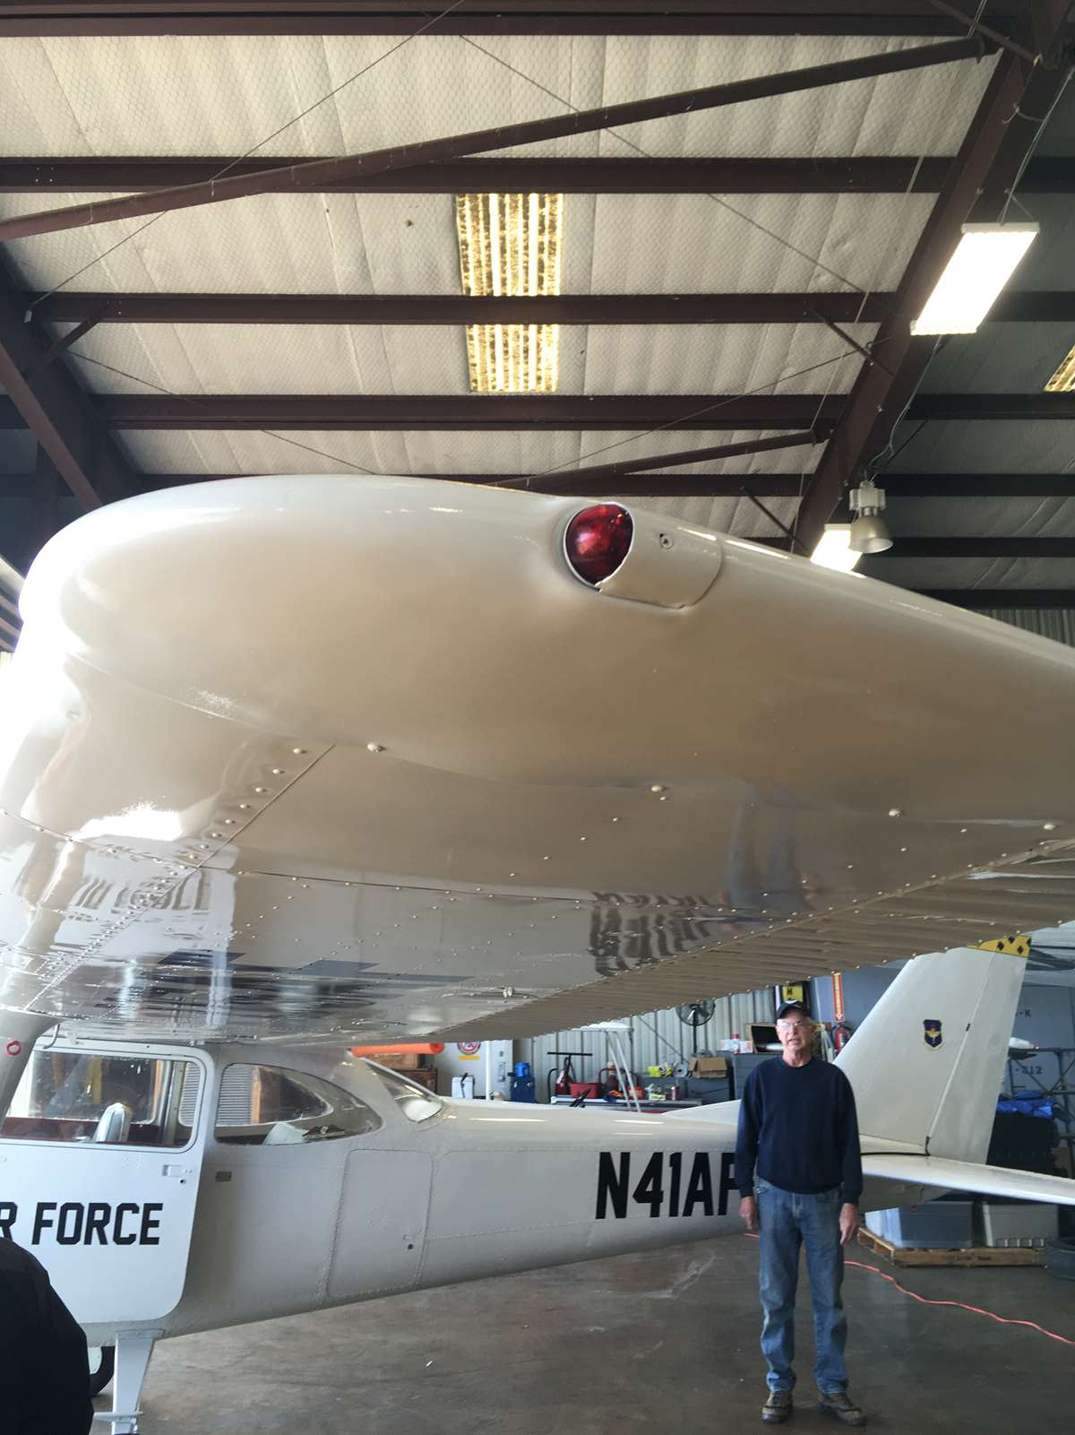
Left wing position light

Slide 16
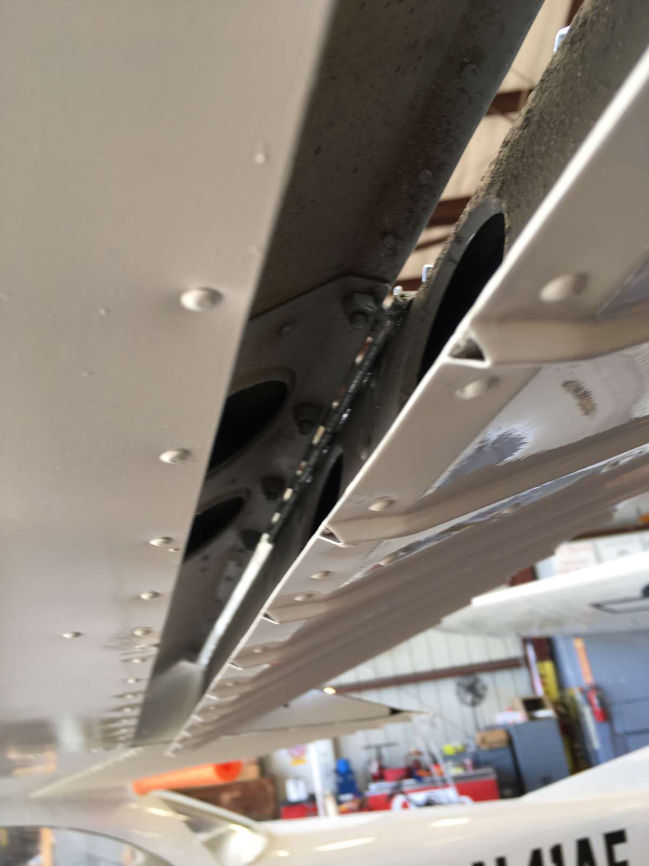
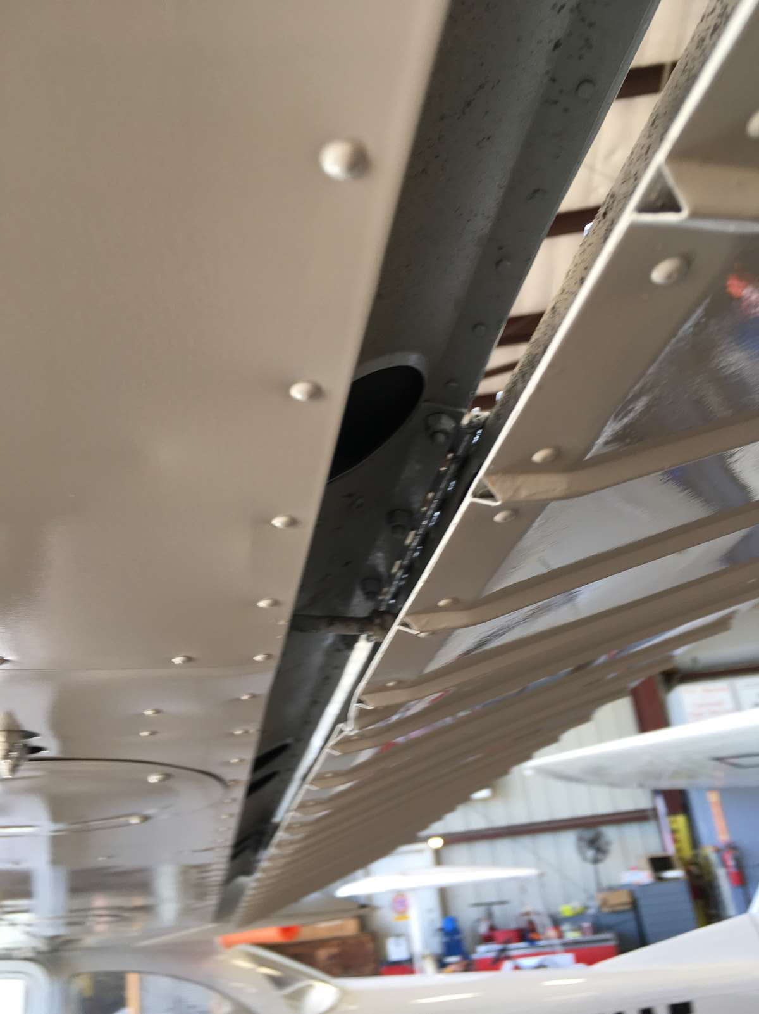
Aileron hinges and drive rod

Slide 17
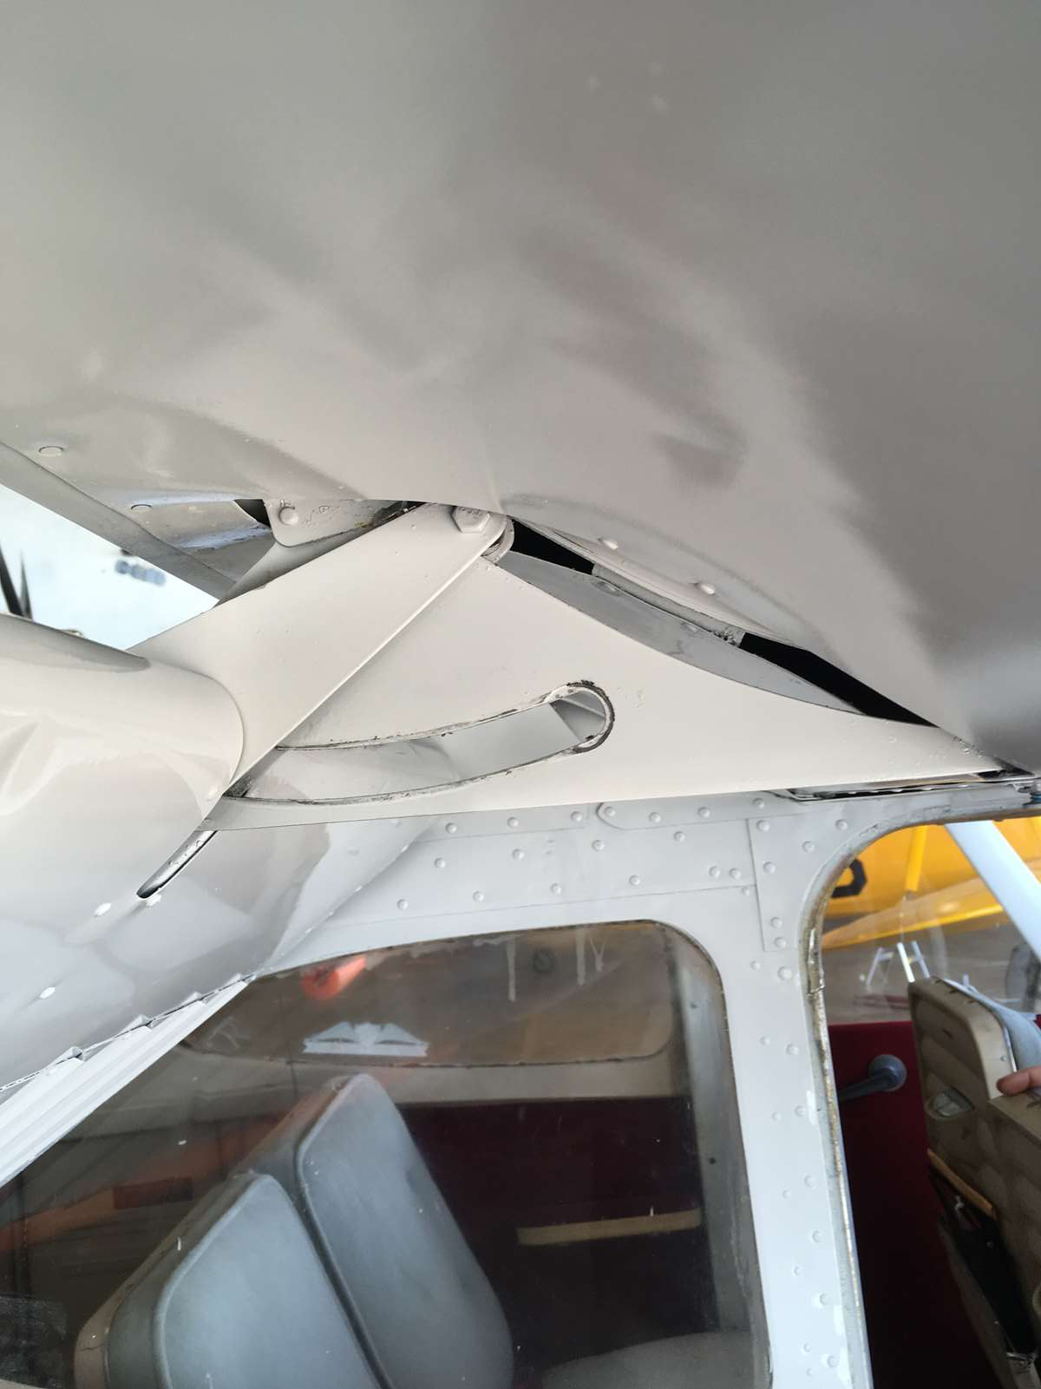
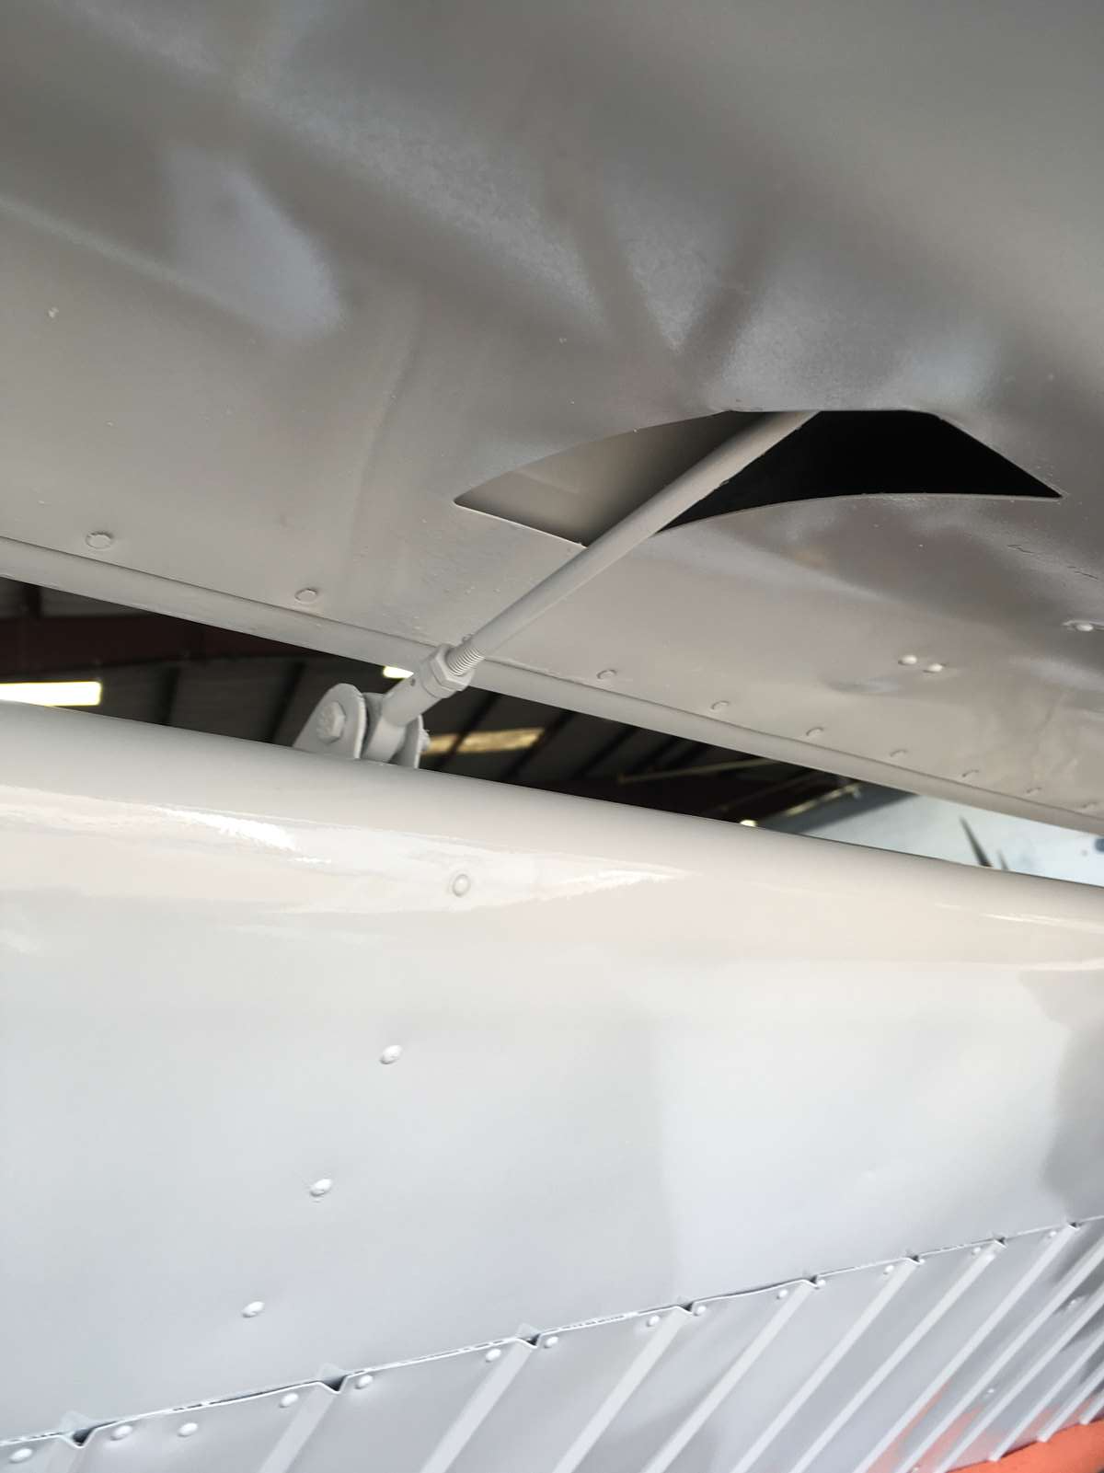
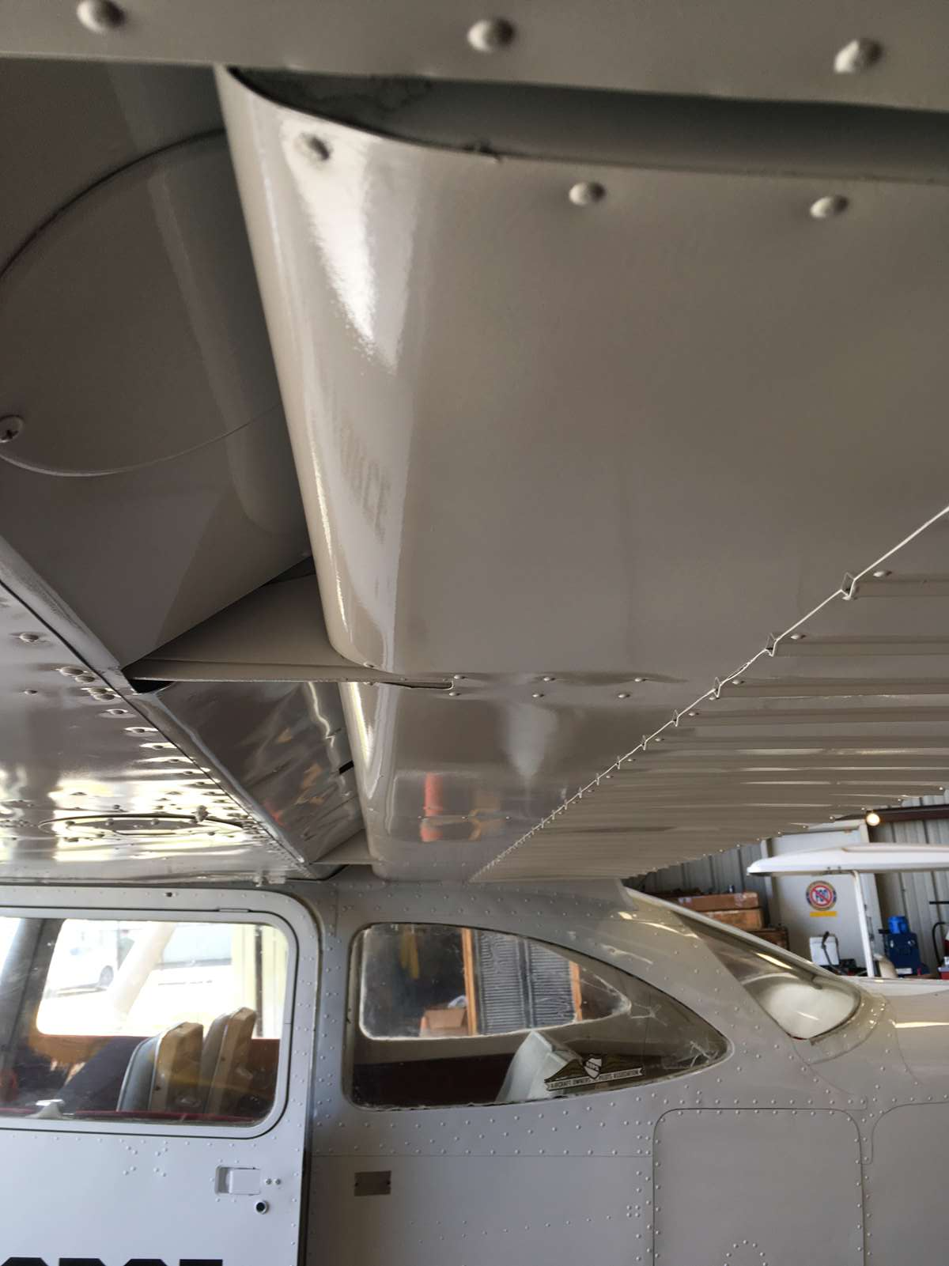
Flap rollers and drive rod

Slide 18
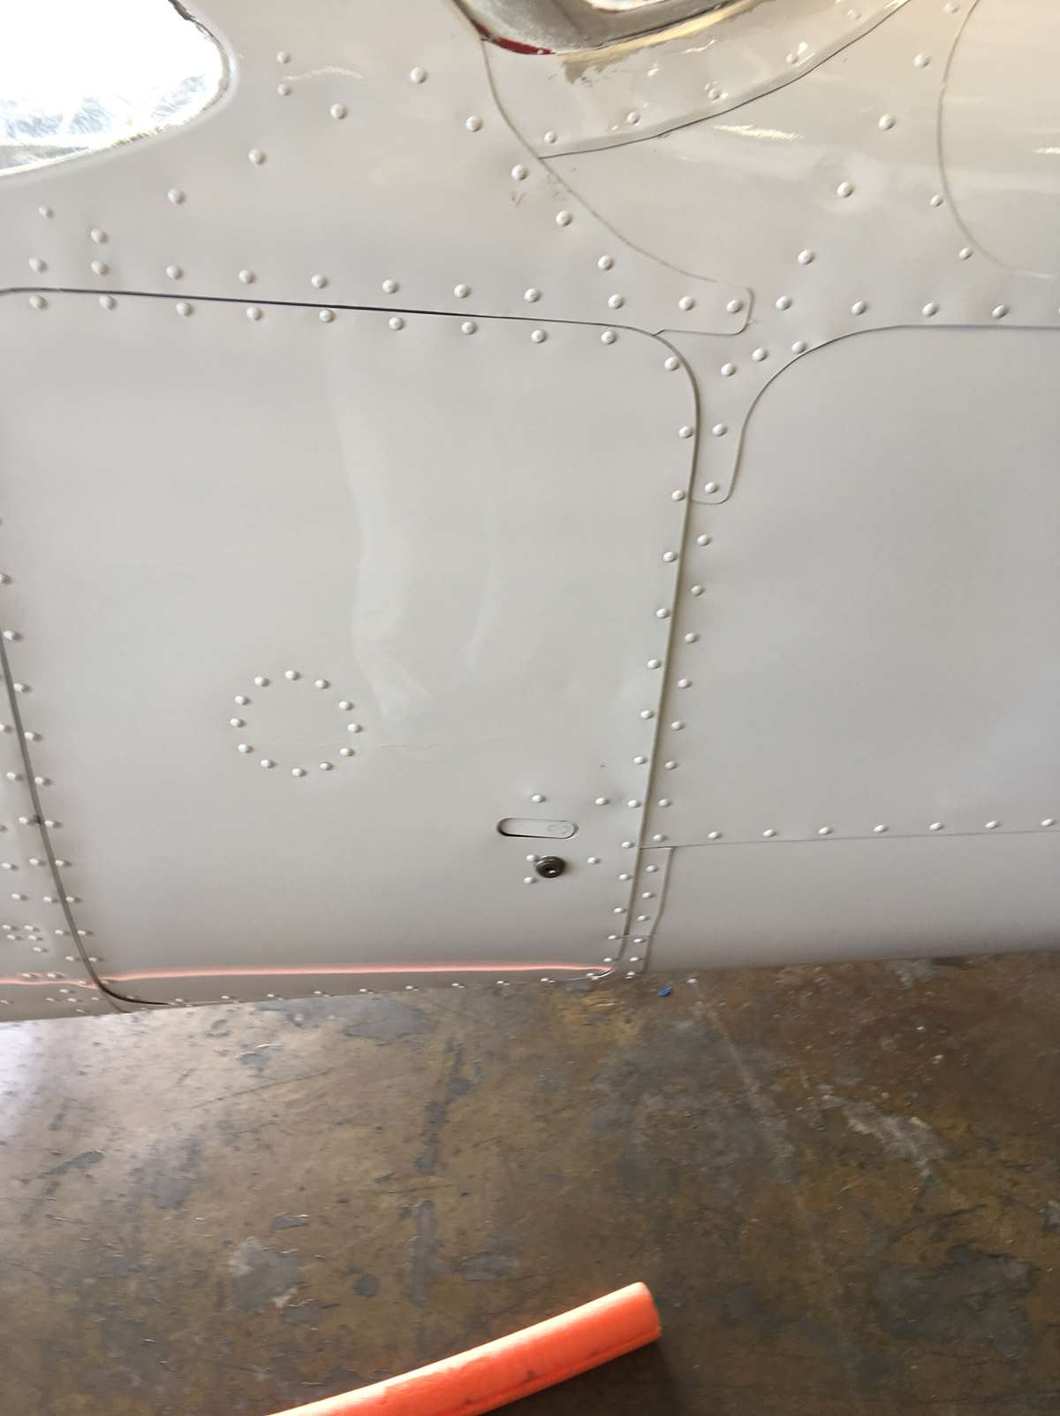
Baggage door

Slide 19
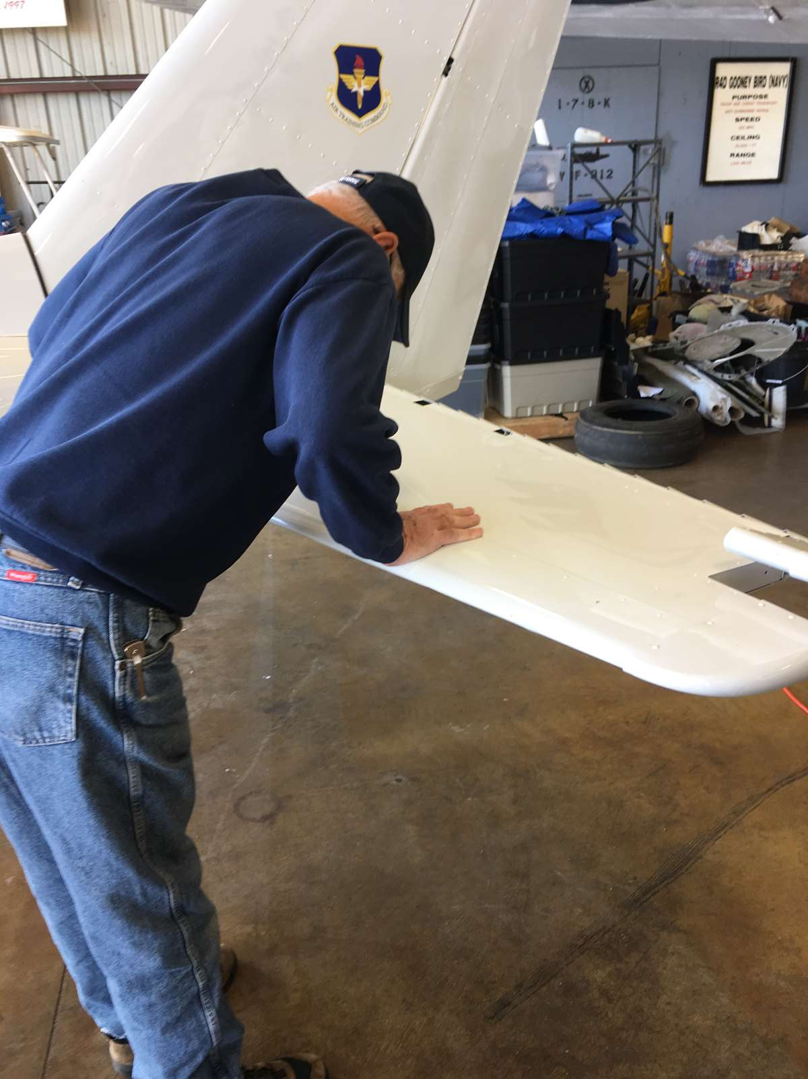
Do not push on this surface!!!

Slide 20
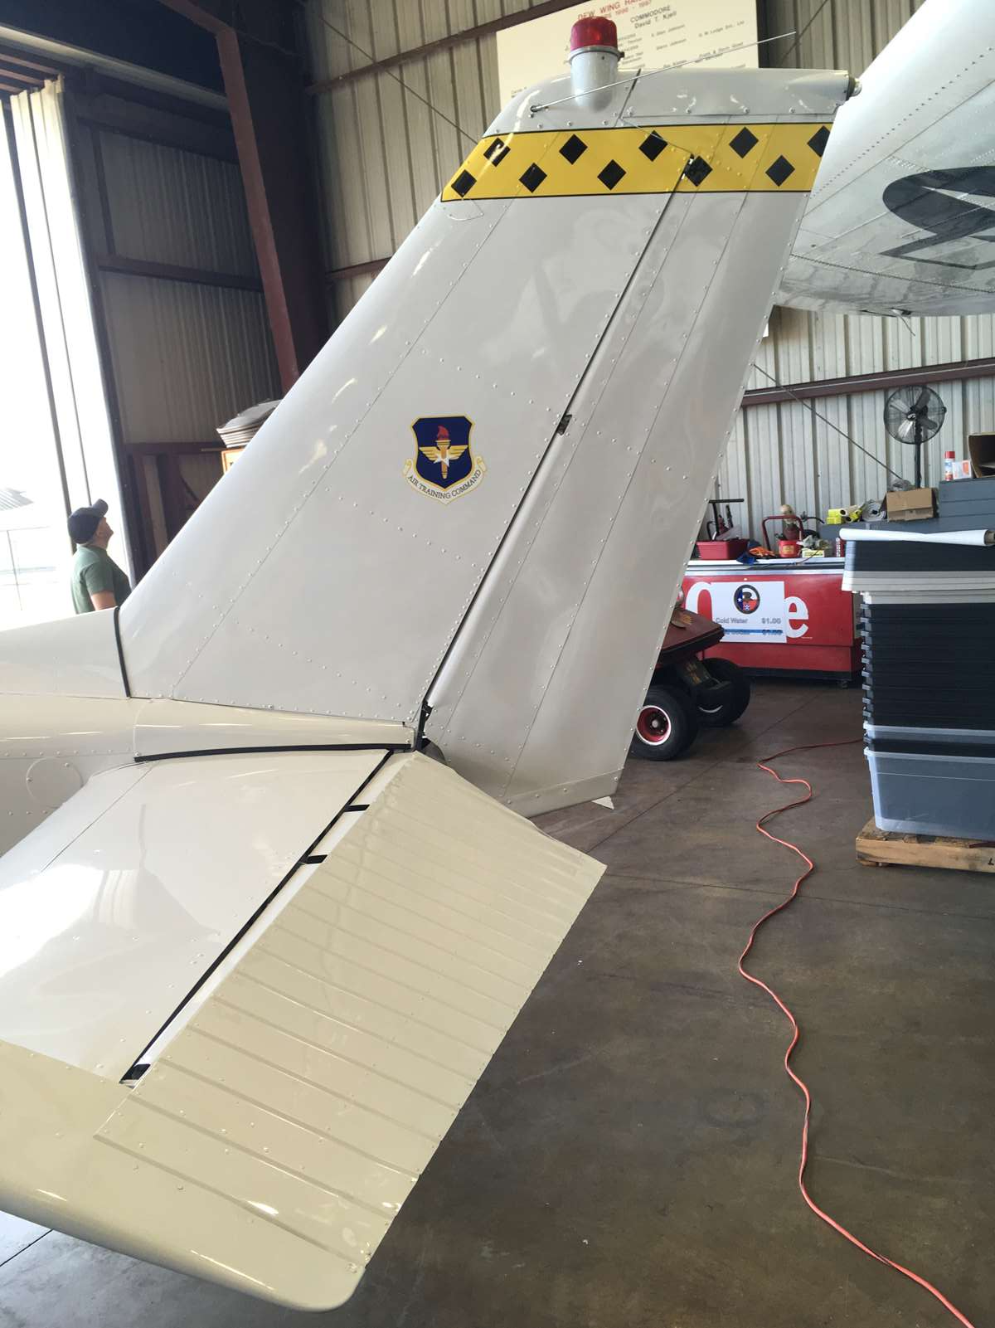
Rudder and elevator

Slide 21
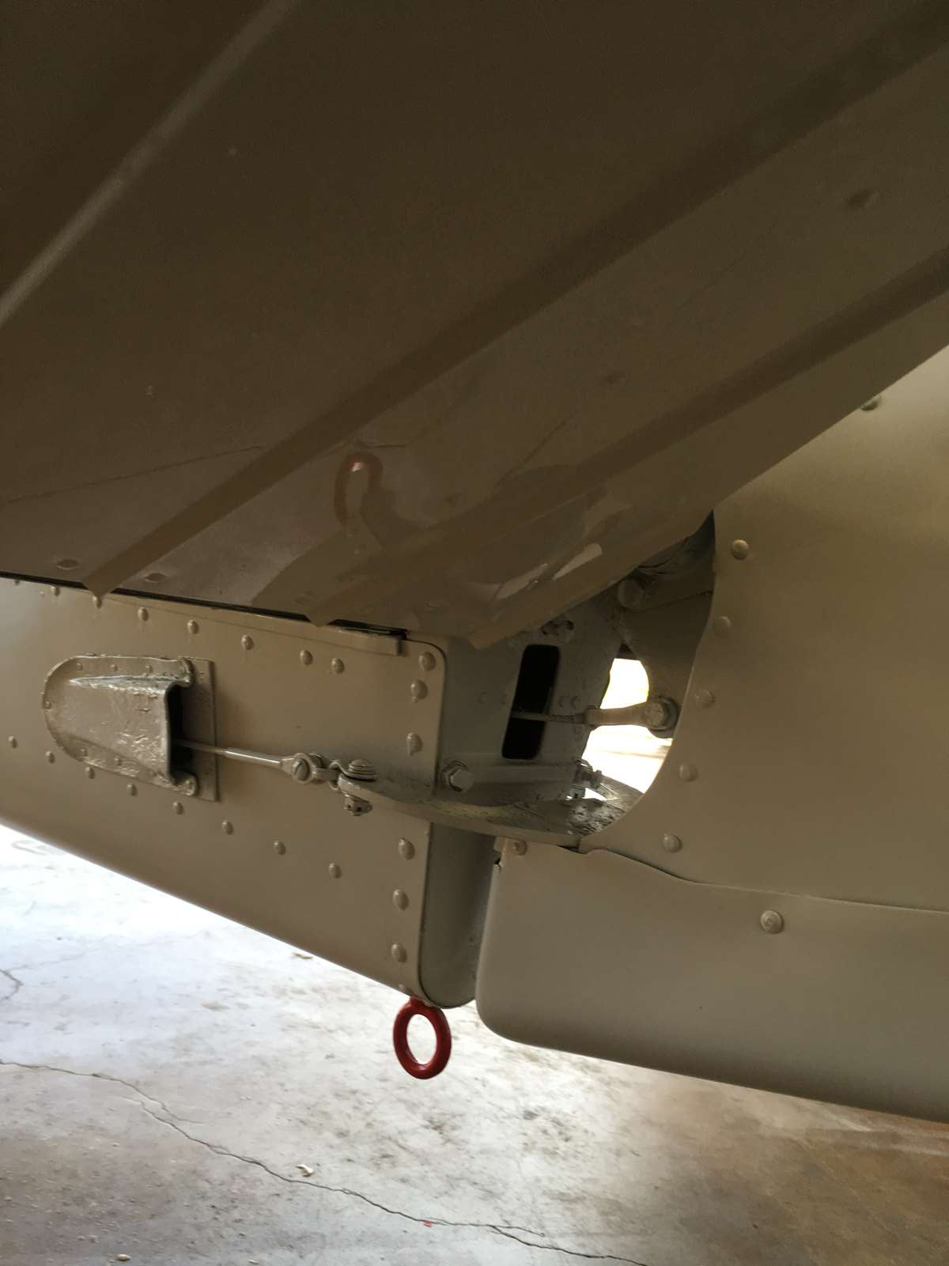
Rudder and elevator drive rods

Slide 22
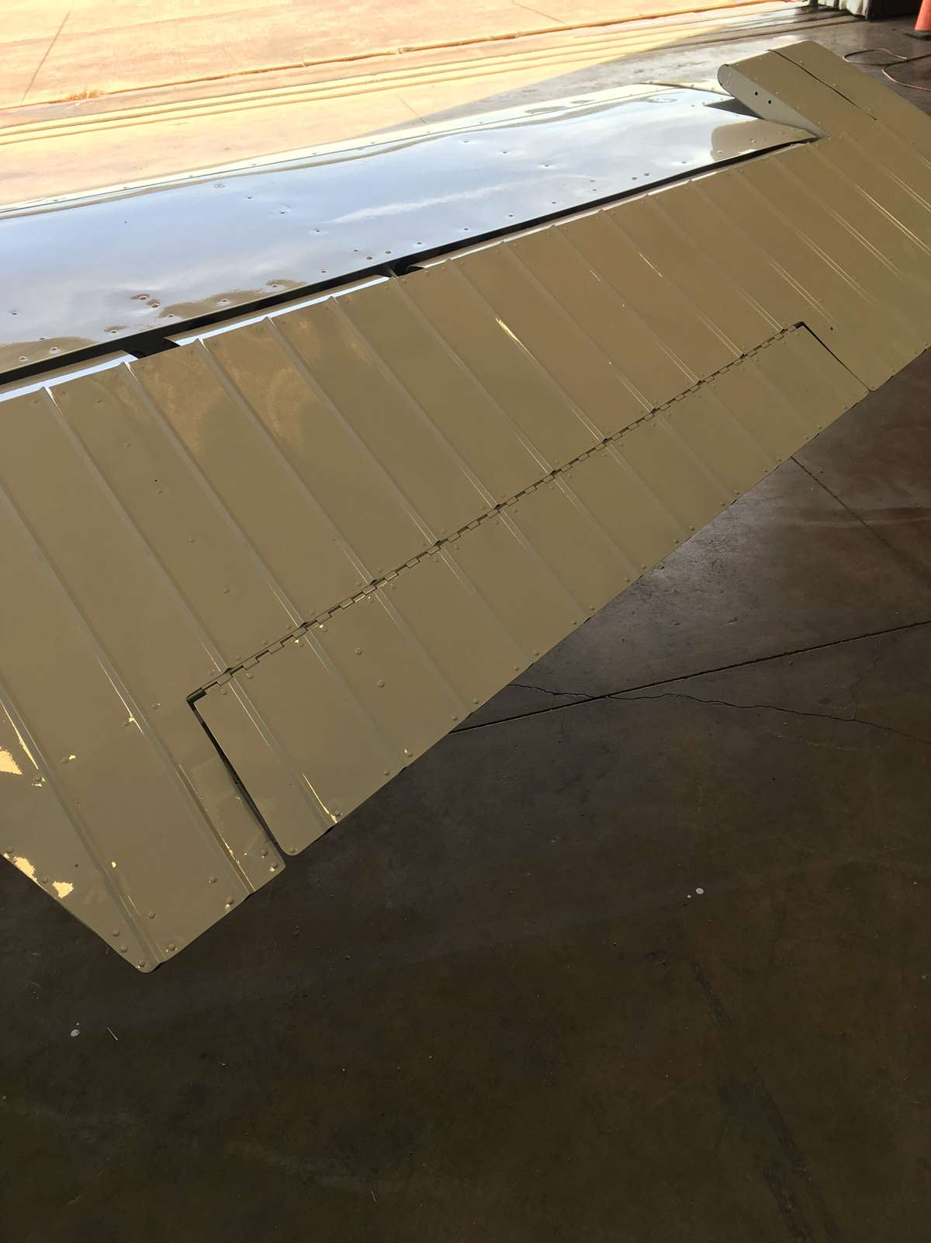
Elevator trim tab

Slide 23
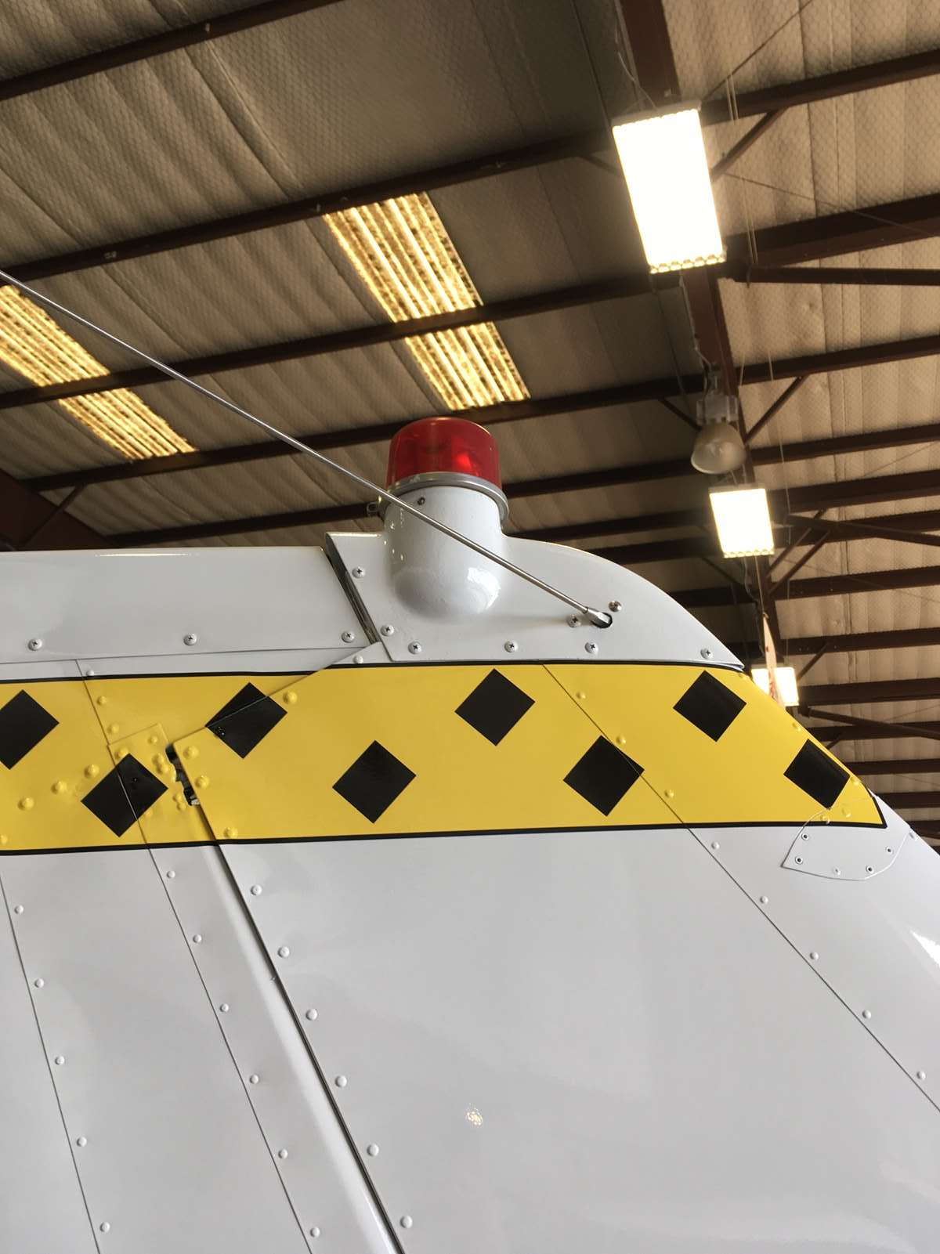
Beacon and VHF antennas

Slide 24
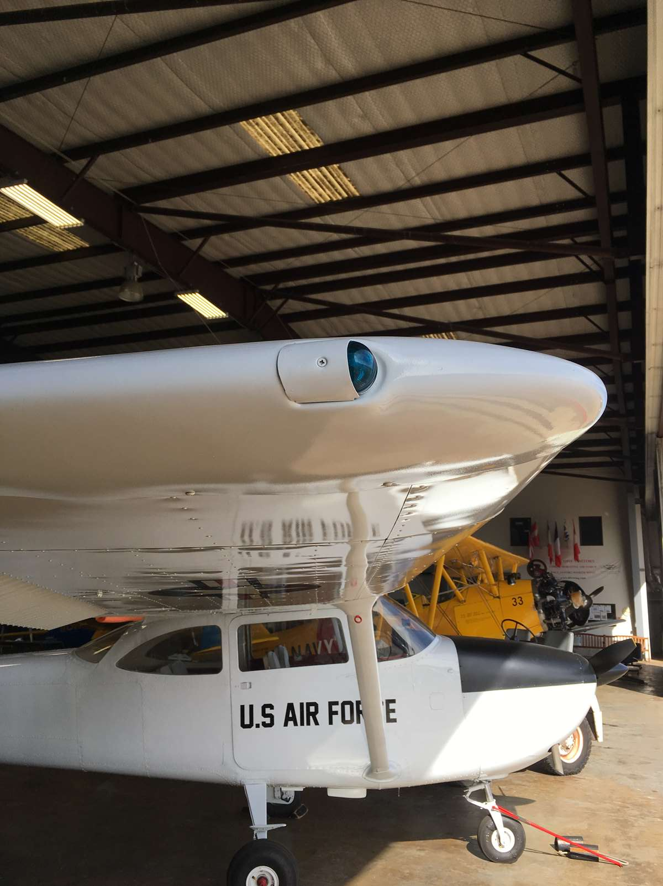
Right wing position light

Slide 25
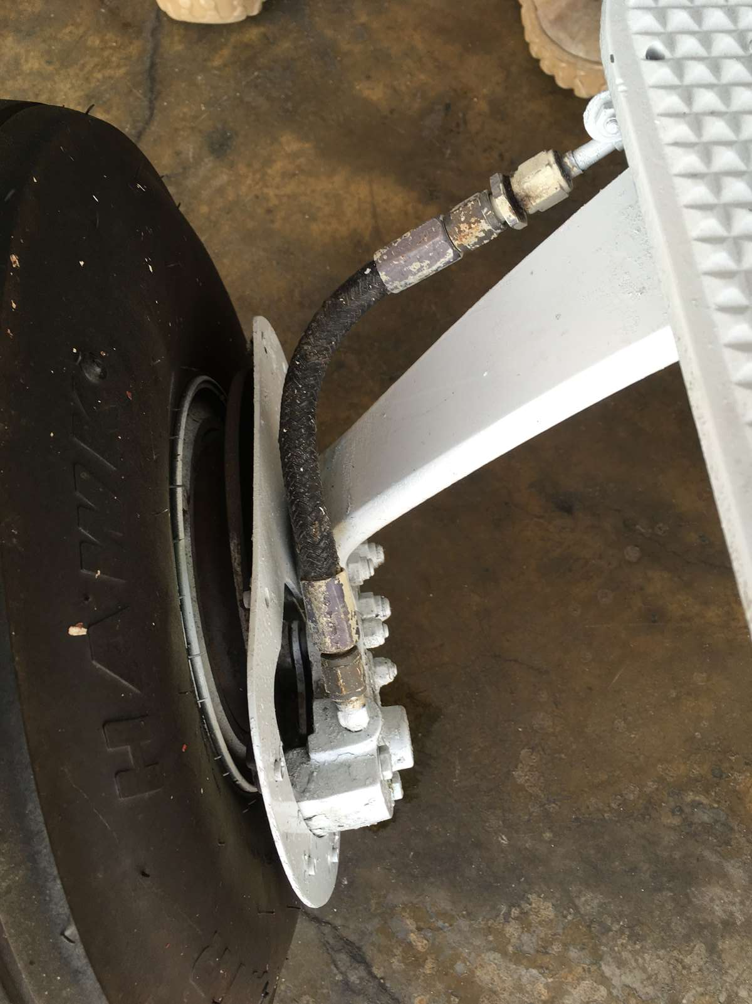
Brakes and brake lines, left and right

Slide 26
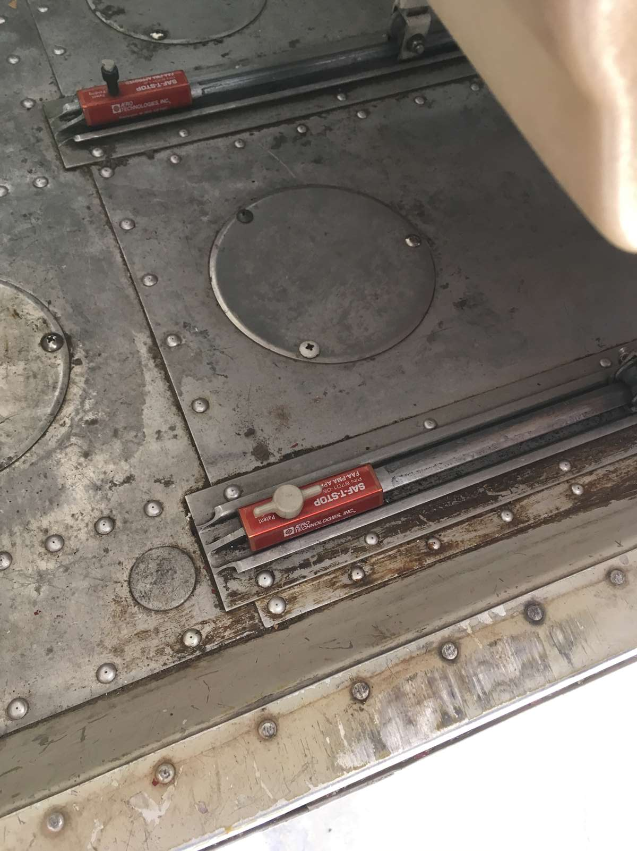
Seat stops, both sides

Slide 27
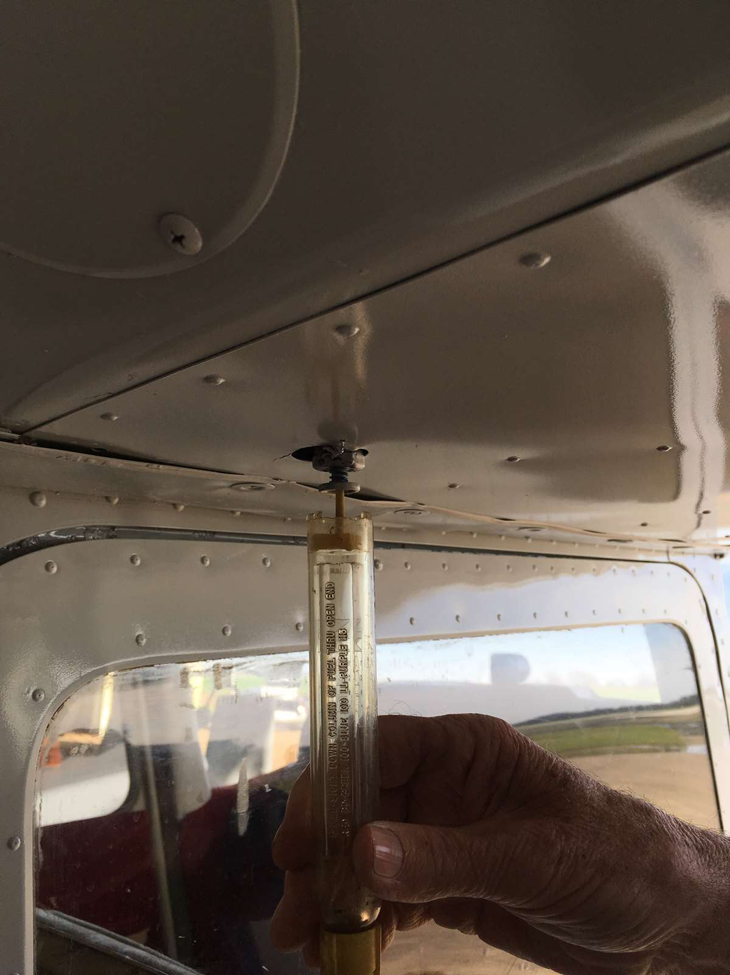
Wing fuel sumps, both sides

Slide 28
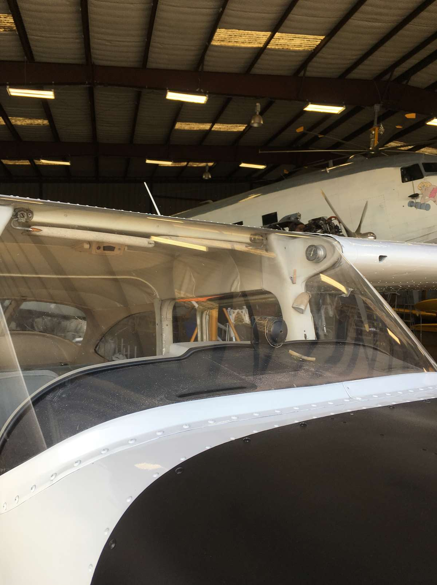
Wind screen Do not clean with Windex or paper towels

Slide 29
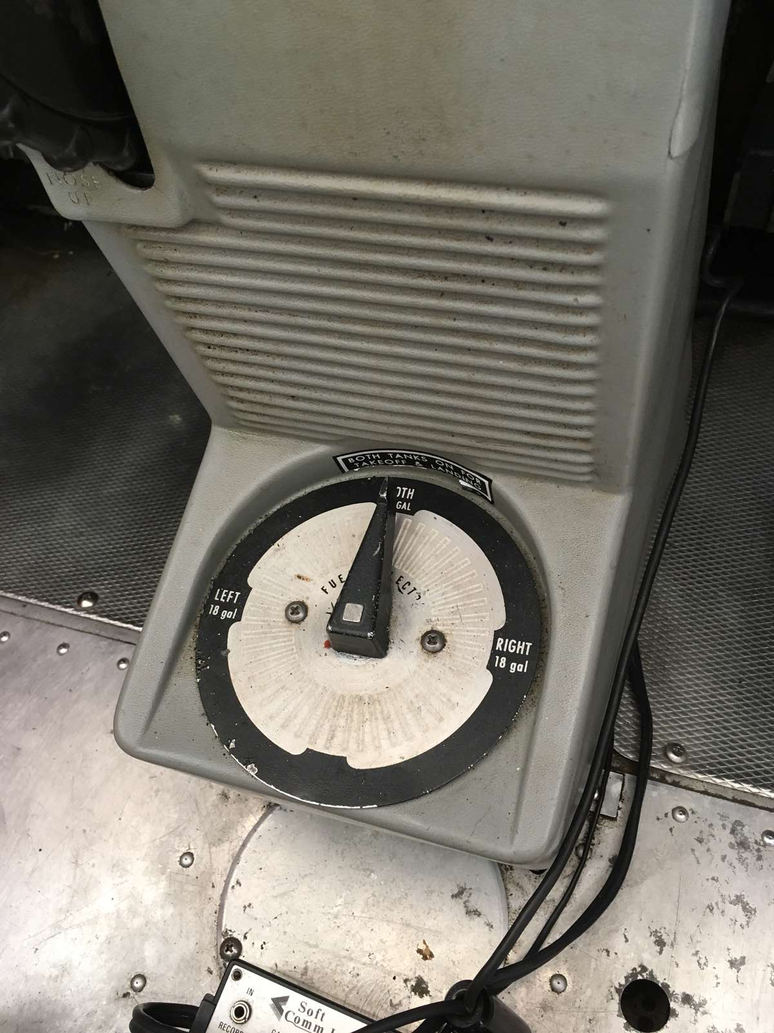
Fuel selector

Slide 30
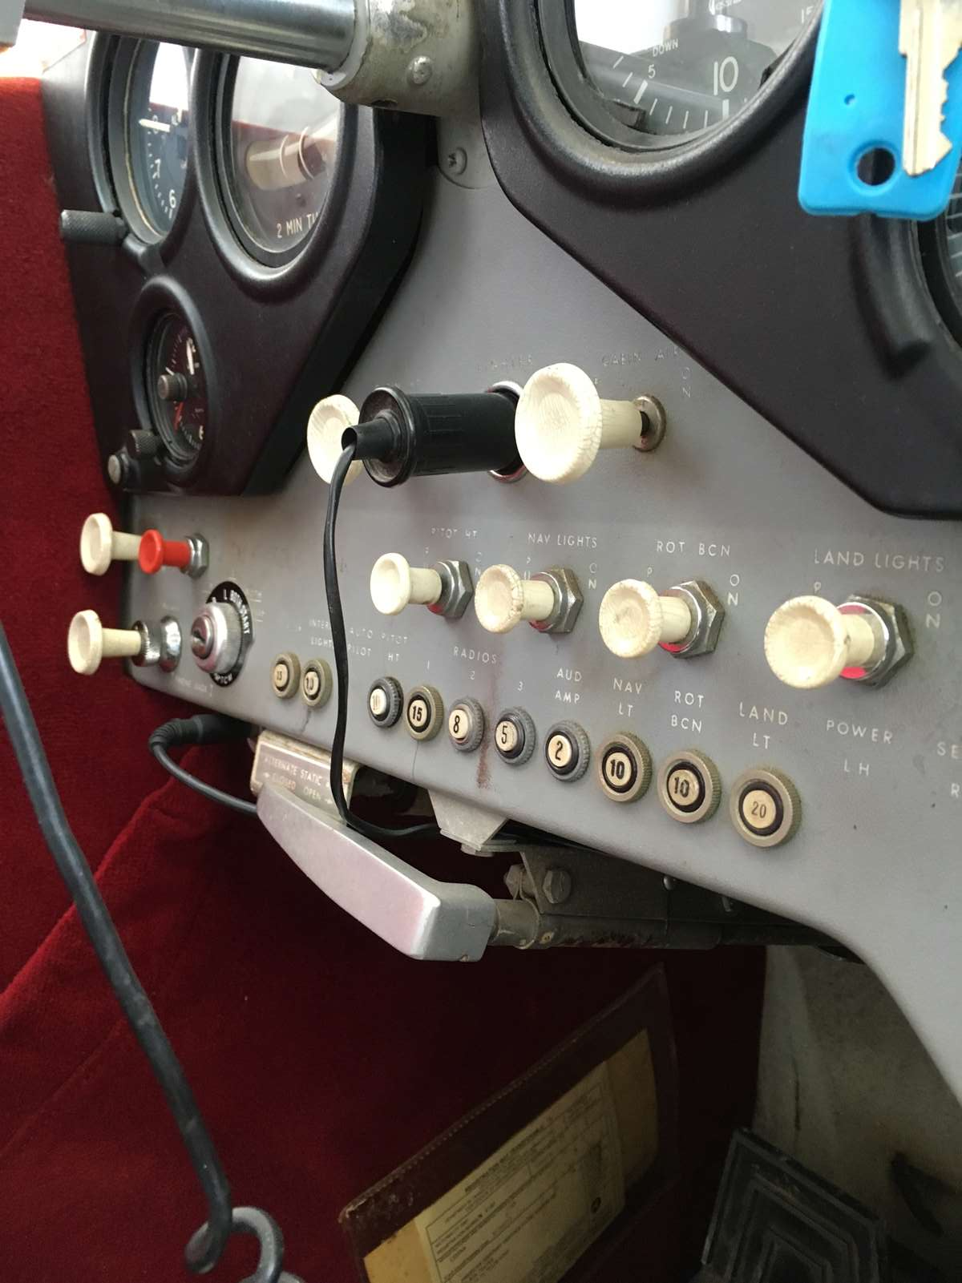
Circuit breakers

Slide 31
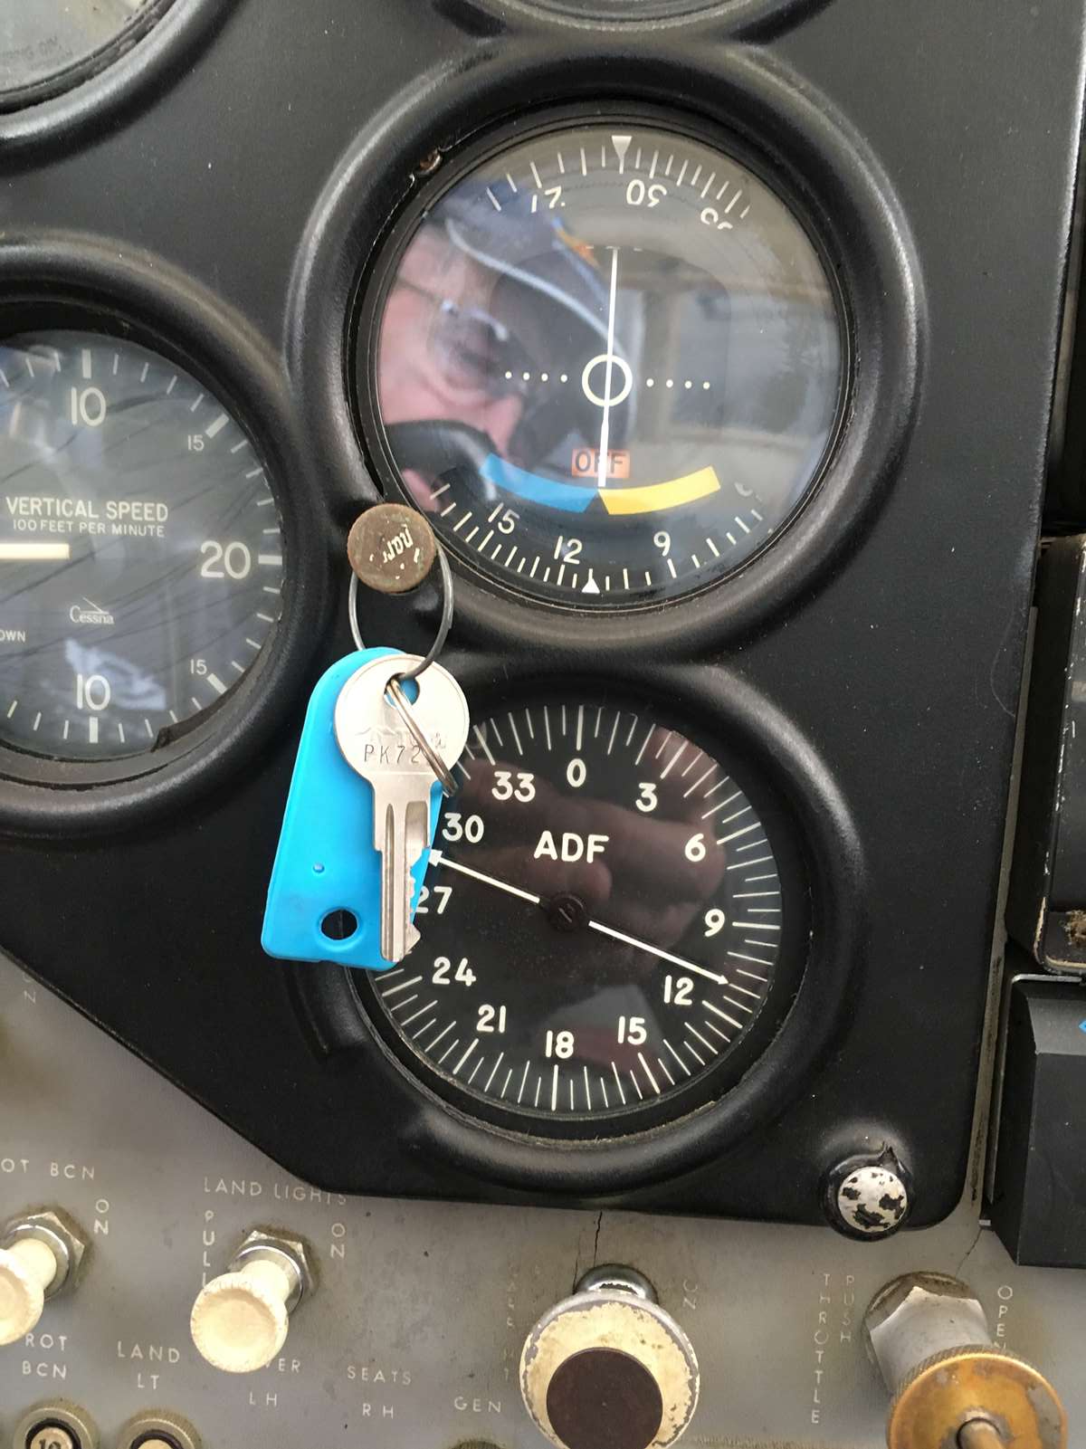
Ignition key

Slide 32
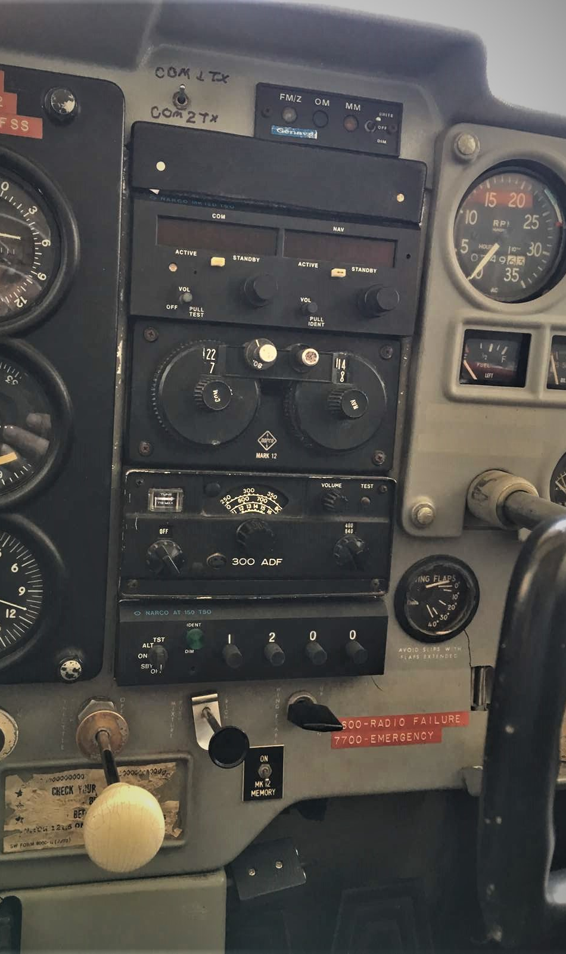
Center panel Radios

Slide 33
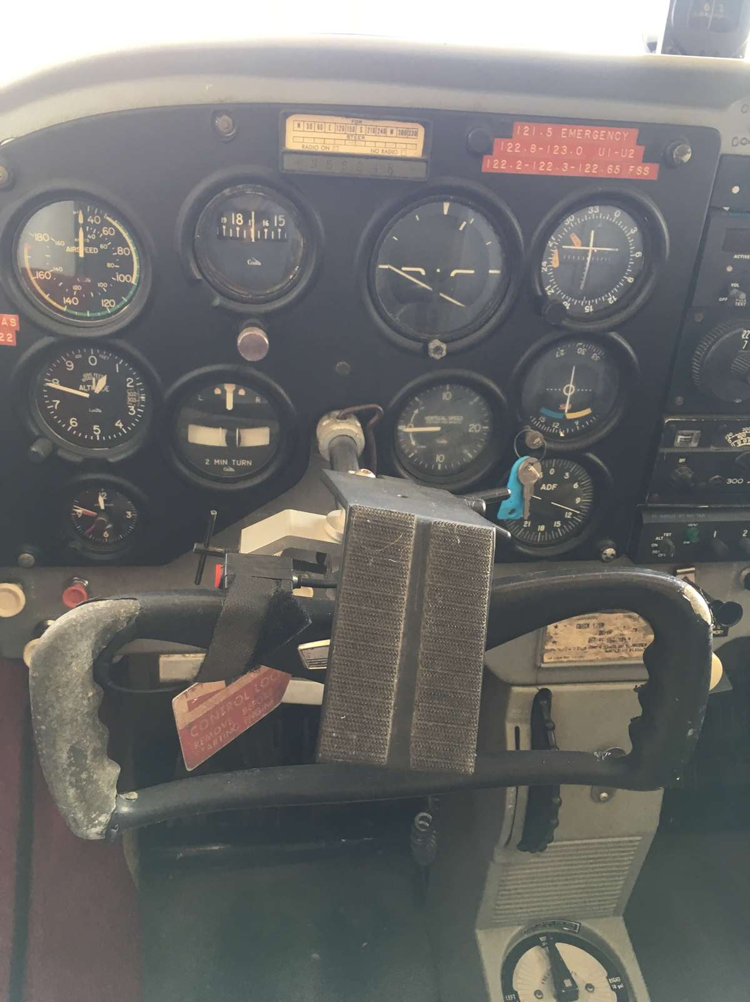
Left panel Flight instruments

Slide 34
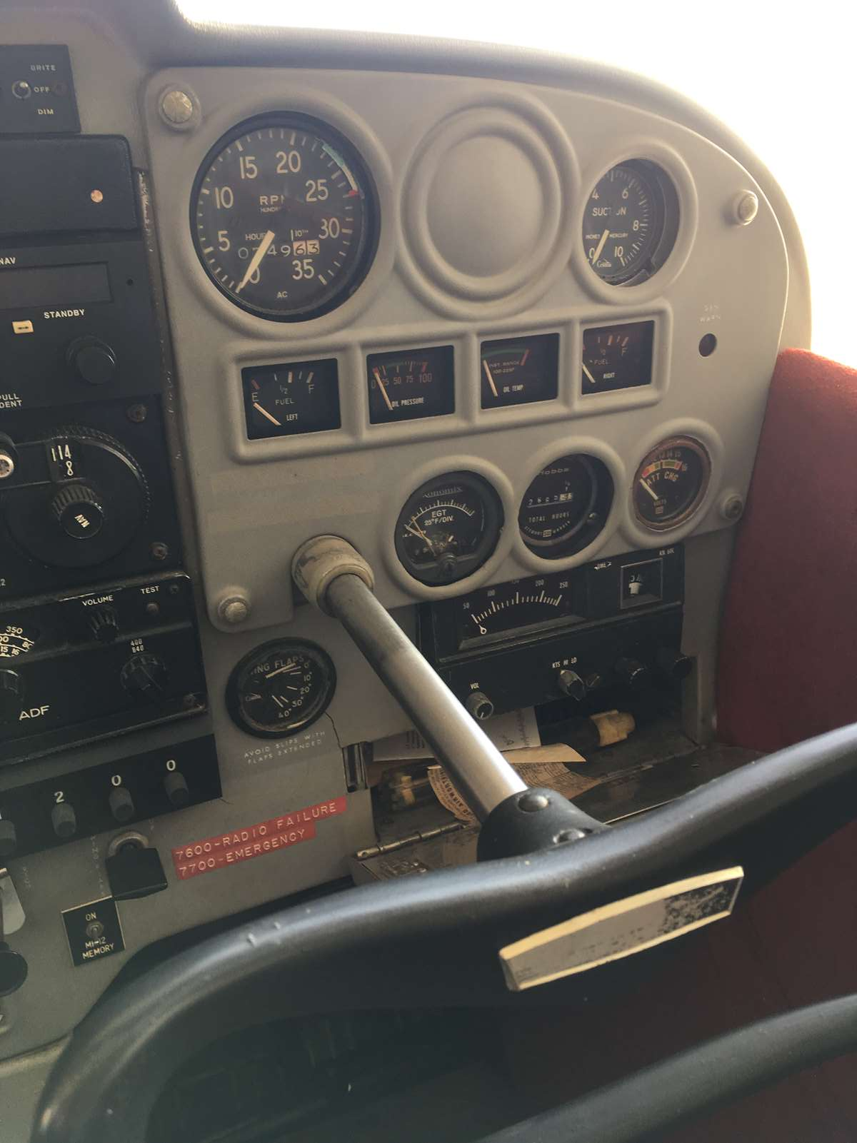
Right panel Engine instrument

