Slide 1
Vultee BT-15
General Characteristics
Crew: 2
Length: 29 ft 1 in
Wingspan: 42 ft 0 in
Height: 12 ft 4 in
Wing area: 239 sq ft (22.2 m2)
Empty weight: 3,375 lb (1,531 kg)
Gross weight: 4,496 lb (2,039 kg)
Powerplant: 1 × Wright R-975-11
nine-cylinder air-cooled radial engine, 440 hp
Performance
Maximum speed: 180 mph (290 km/h; 156 kn)
Range: 725 mi (630 nmi; 1,167 km)
Service ceiling: 21,650 ft (6,599 m)
1
Single Engine Ground

Slide 2
BT-15
General
Fuel: 60 gallons per side, 17 gallons of 60 is reserve on right side
Oil: 8.5 gallons (normal), 10.9 (overflow).
Normal Takeoff use 20º flaps
Climb at 90mph until flaps are retracted, then 100mph
Mag check 1700 rpm, max 100 drop
Field Baro Check at 2150 RPM
Maximum Baggage Capacity 175 pounds
2
Single Engine Ground

Slide 3
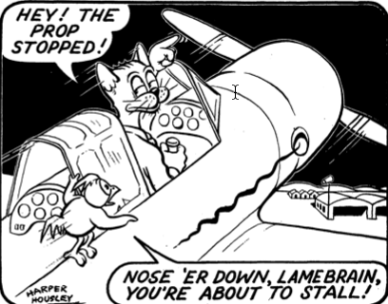
BT-15
Speeds
All in MPH
90 works for everything
Vy 90 with 20 flaps
Vy 100 with flaps up
Vne 207
Vno 177
Vfe 111
Vs 72
Vso 30 flap 65
Vso 60 flap 62
3
Single Engine Ground

Slide 4
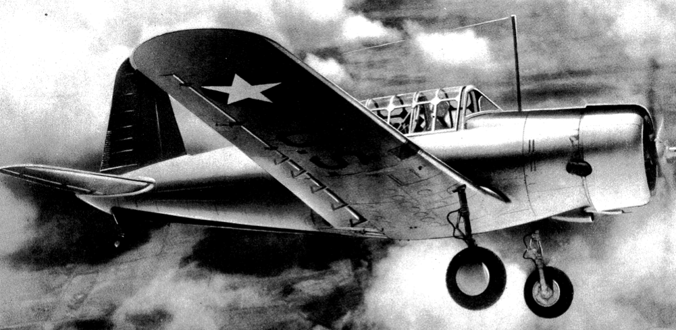
BT-15
Power Settings
Takeoff Full/2250 1minute
METO Full/2200 cont.
Climb 31/2100
Cruise 26/1900
4
Single Engine Ground

Slide 5
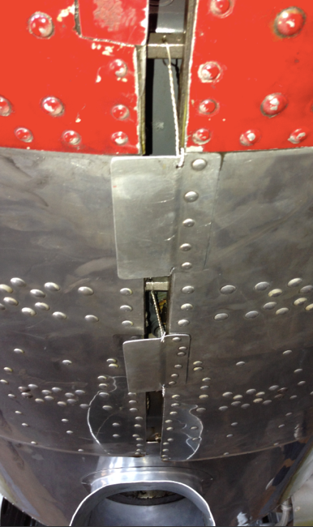
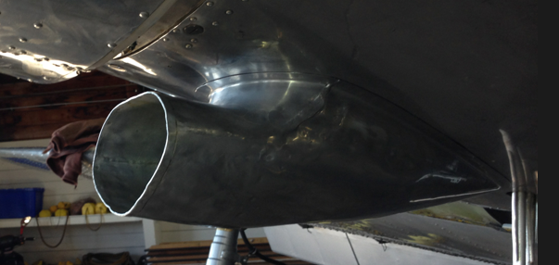
BT-15
Preflight
4 sumps, one under door.
Bottom intake is oil cooler.
Side intake is carb air inlet.
Make sure that all 3 wires are
secure in bottom of cowl.
5
Single Engine Ground

Slide 6
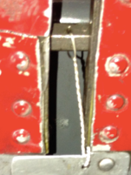
BT-15
Preflight
As with any radial engine the R-975 can retain oil in the cylinders if not flown for a period of time. Prop should be pulled through 7 blades to ensure all cylinders are cleared.
Cowling locking bolts and safety wire must be checked prior to flight.
6
Single Engine Ground

Slide 7
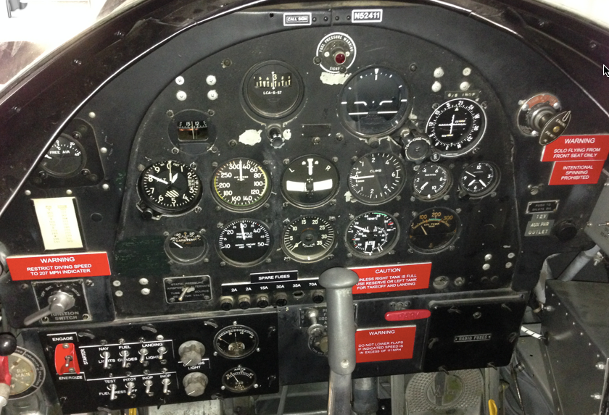
BT-15
Instruments
Both front and rear cockpits are equipped with the same instruments.
You cannot start the engine from the rear cockpit.
7
Single Engine Ground

Slide 8
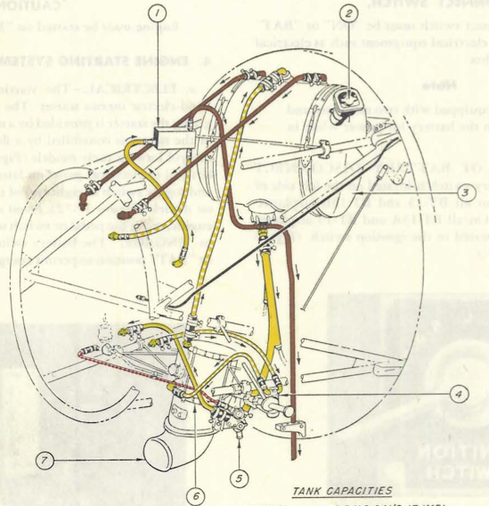
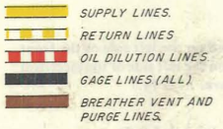
BT-15
Oil
The oil tank, located on the firewall, holds 10.9 gallons of oil. Normal operation is 8.5 gallons.
8
Single Engine Ground

Slide 9
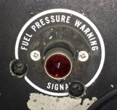
BT-13
Priming
Priming is accomplished by pumping the wobble (red handle) until the low fuel pressure light goes out. Then adding prime via the primer located in the upper right of the panel.
9
Single Engine Ground

Slide 10
BT-15
Inertia Starter
The inertia starter is spooled up by holding the starter switch down to the Energize position.
* There is not a need to hold it for an extended period of time.
Start is accomplished by then moving the switch to the up position.
10
Single Engine Ground

Slide 11
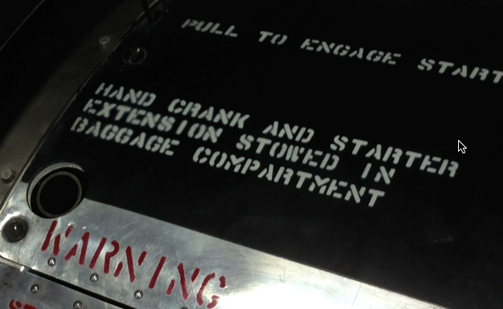
BT-15
Hand Start
The inertia starter can be turned by hand in the event battery power is not available. The crank, located in the baggage compartment, is inserted into the inlet.
Pilot MUST NOT engage starter until person cranking calls start.
11
Single Engine Ground

Slide 12
BT-15
Flaps
Flap extension speed: 111 MPH
Extension at higher air speeds causes stress on the flap attach points. This can result leaking from the fuel tanks... Or worse.
12
Single Engine Ground

Slide 13
BT-15
Flap Extension
Flaps are extended or retracted by turning the yellow crank. Each turn equals 2º of flap movement. May be operated from front or rear cockpit.
Make sure passengers are briefed that the spinning flap handle could hit their ankle if it is placed in the arc of the handle.
13
Single Engine Ground

Slide 14
BT-15
Unlocking The Tail Wheel
The steerable, self-centering tail wheel is interconnected with the rudder through shock absorber springs and provides steering throughout the rudder arc. Beyond this arc, the wheel is free to swivel and will reengage when it returns to a position within the rudder arc.
14
Single Engine Ground

Slide 15
BT-15
Canopy
Passengers should be briefed on the operation of the canopy. To open grasp the yellow handle and twist in either direction. Release to set lock pins.
Canopy can be in any position for any phase of flight.
15
Single Engine Ground

Slide 16
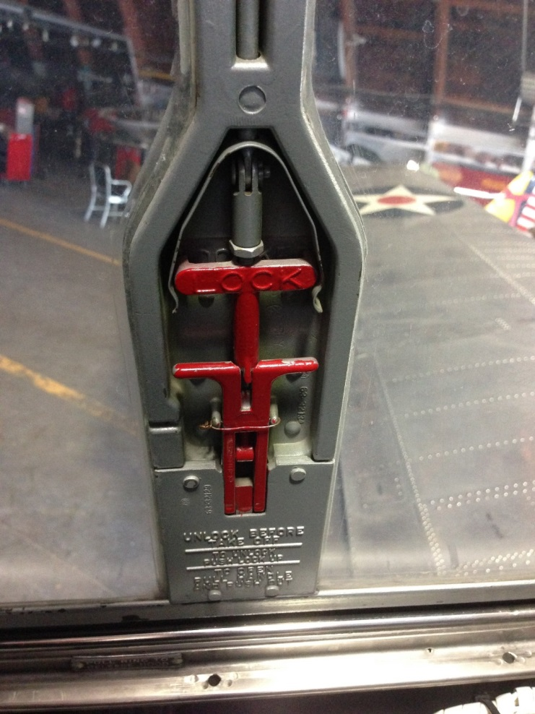
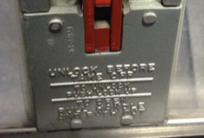
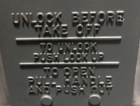
BT-15
Emergency Exit
Emergency panels are located in both front and rear canopies. Passengers should be briefed on the operation prior to flight.
16
Single Engine Ground

Slide 17
BT-15
System Questions
What is the fuel capacity?
What is the reserve fuel? Which tank?
What is the maximum flap extension speed?
How many degrees per turn does the flap handle move the flaps?
How is the tail wheel unlocked?
120 gallons
~17 gallons, Right
111 MPH
2º per turn
By turning the aircraft beyond the normal turning arc.
17
Single Engine Ground

Slide 18
BT-15
System Questions
What is normal TO distance, 80F, Sea Level?
What is the normal power setting for TO?
What is the minimum amount of oil?
What is the best glide speed?
What are the stall speeds?
1500 feet
Full / 2250 rpm
~7 gallons (not listed)
90MPH
Vs0 72MPH, 30º flaps 65MPH, 60º flaps 62MPH
18
Single Engine Ground

Slide 19
BT-13
System Questions
What is desired engine oil pressure in flight?
What is the desired engine oil temperature in flight?
What speed is Vne?
What is the maximum gross weight?
What is the maximum baggage weight?
70 to 75 PSI
50 to 70 Degrees C
207 MPH
4496 pounds
175 pounds
19
Single Engine Ground

