Slide 1
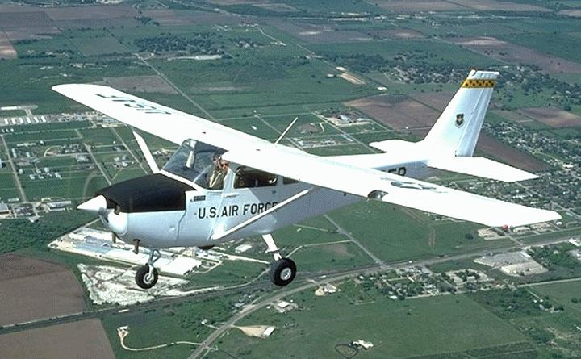
Title Layout
T-41A Ground School
DFW Wing CAF

Slide 2
T-41A background
The Cessna 172 first flew in 1955 and is still produced today. Total production is about 40,000, the most built aircraft of all time.
In the early 60's , the USAF was using an all jet training approach. However, the wash out rate of unsuitable pilots was too costly. Bids were requested for an “off the line” civilian aircraft. Cessna won the contract using a production C-172. Later versions were modified with bigger engines for the Air Force Academy and other services. These will not be covered here.

Slide 3
Our DFW wing T-41A “Mescalero” started life as a 1965 172F. It did not see military action and is actually a T 41 clone. (Just between us) It is the CAF’s first, and so far, only T-41A.

Slide 4
Cockpit layout

Slide 5
Aircraft description
Cessna N5524R is flown in the normal category and therefore is prevented from aerobatic maneuvers including spins.
Operational Data
Max gross wt - 2300 lbs
Empty wt - 1422 lbs
Fuel cap - 39 gals
Oil cap - 8 qts. ( 6 qts min at take off. Do not fill above 7 qts. )
Stall speed - Power off 0 flaps - 57 mph
40 flaps - 49 mph

Slide 6
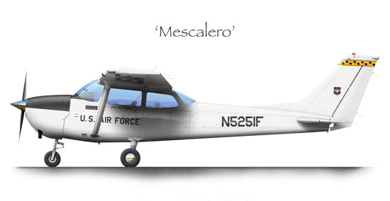
Operation
Flaps at 0 is best for all but short field take offs. Lift the nose wheel at 60 MPH and let it fly off.
85 MPH is best rate - Vy
65 is best angle - Vx
Approach speeds between 60 and 80 are best. Don't go below about 70 unless flaps are full.
Above 80 just burns runway and YOUR tires.

Slide 7
Emergency procedures
The 1965 POH does not have emergency procedures!! Some common sense items in case of engine failure would be;
Carb heat to full on
Mixture full rich
Slow to 80 MPH for best glide.
Switch tanks. If on both, switch to the fullest tank for 60 seconds and then to the other tank. This is for vapor accumulation reasons.
Aviate / navigate / communicate. Don't panic. Glider pilots do this for every landing.
Many people try to stretch the glide and stall. If you don't like the spot you are going to hit, maintain airspeed, keep the wings level, avoid obstacles and dissipate energy.

Slide 8
Engine instruments

Slide 9
Additional info
Fuel sump drain is below the fuel filter. Drain control in cockpit is disconnected.
Flaps in 1965 were allowed to 40 degrees. Newer 172s are limited to 30.
Do not use full flaps in cross winds. Do not slip with flaps over about 20 degrees.
5524R does not have flap limit switches up or down. You must hold the flap
handle until desired position is reached. When the flaps are full up a loud
squeal will sound. (You may not hear this with headsets on. )This means let go of the switch. Do not trust the flap position indicator.
A good cruise RPM range is about 2200 to 2400 at normal altitudes. Trying to go fast just makes more noise and burns more of your gas.

Slide 10
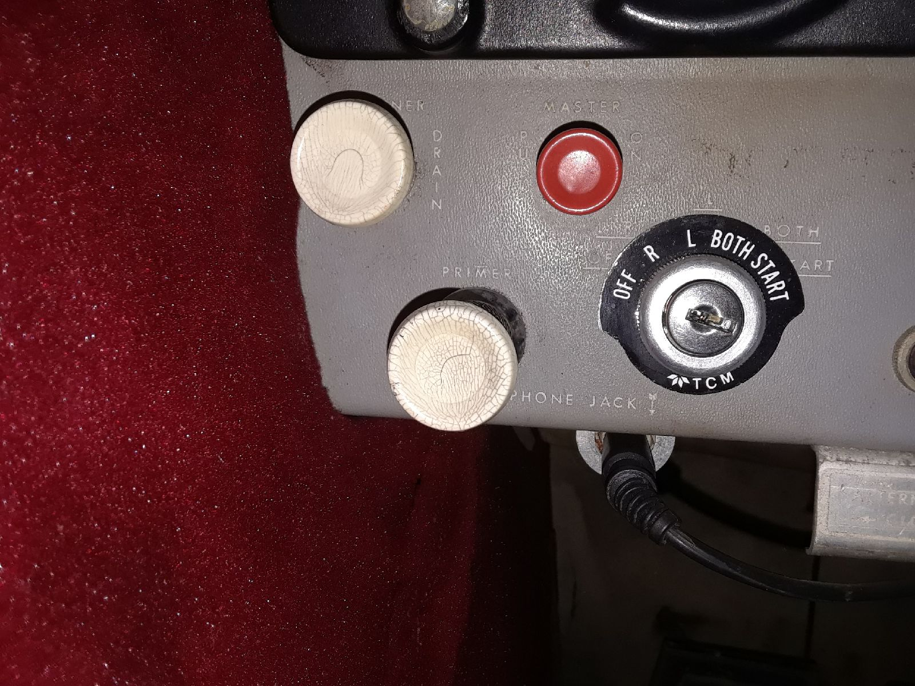
Fuel Sump in wheel well
Inop in cockpit

Slide 11
Additional info continued
Carburetor heat is NOT mandatory. The POH states “ as required”. Use it
for landings and low power settings or when icing suspected.
The cabin air knob is backwards. All other controls are normally IN. Cabin air is OUT for fresh air.
Never push on the horizontal stabilizer when moving the aircraft.
The aircraft airworthiness certificate and registration is in the pocket by the
pilots left foot. Weight and balance info is in the pilots seat back. The flight log
is also in the seat back. Fill out both logs after every flight.

Slide 12
Comm panel on floor

Slide 13
Quiz
1. What is the difference between a 172F and the first T 41s ?
________________ ( one word)
2. What is the full fuel usable load of 5524R ?
______________ Pounds
3. During run up, you should leave carb heat on for 5 to 10 seconds.
Why ? _________________________________
4. When would use 30 or 40 degrees flap for take off. ____________________
5. You are high on final. You have full flaps on. Should you use a forward slip or side slip to lose more altitude? _______________________________

Slide 14
Quiz continued
6. You have full flaps and are forced to go around. Explain
how to raise flaps and what will happen if you do it wrong.
7. How should you hold the controls for taxi with a right rear
tail wind?
8 .Describe a cross wind landing.
9. Do you need a flight suit to fly this airplane?
10. 5524R does not have a 406 MHz ELT. Are you required to
maintain the obsolete 121.5 ELT?
11. The rating you are testing for requires a spin. How do you
convert the airplane to Utility category?

Slide 15
Ground school finished
After completion of this online course, contact the Operations Officer to receive credit for your annual review.
Fly Safe!

