Slide 1
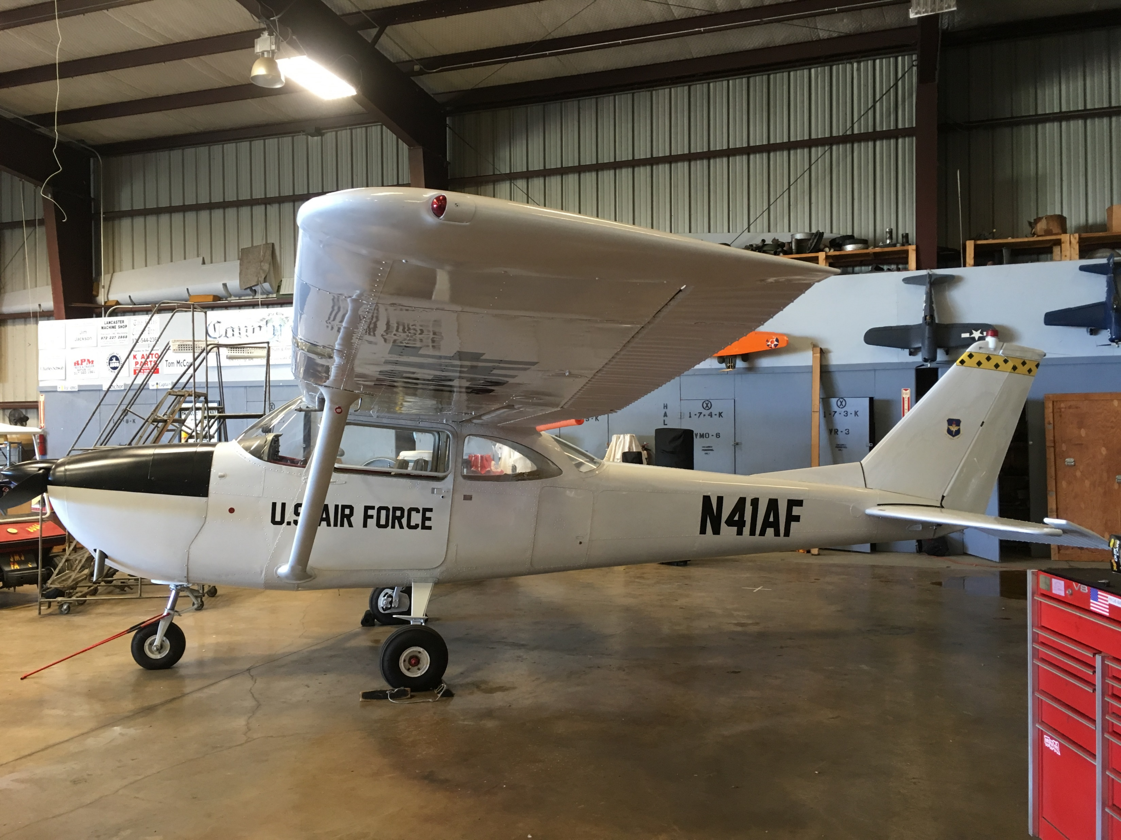
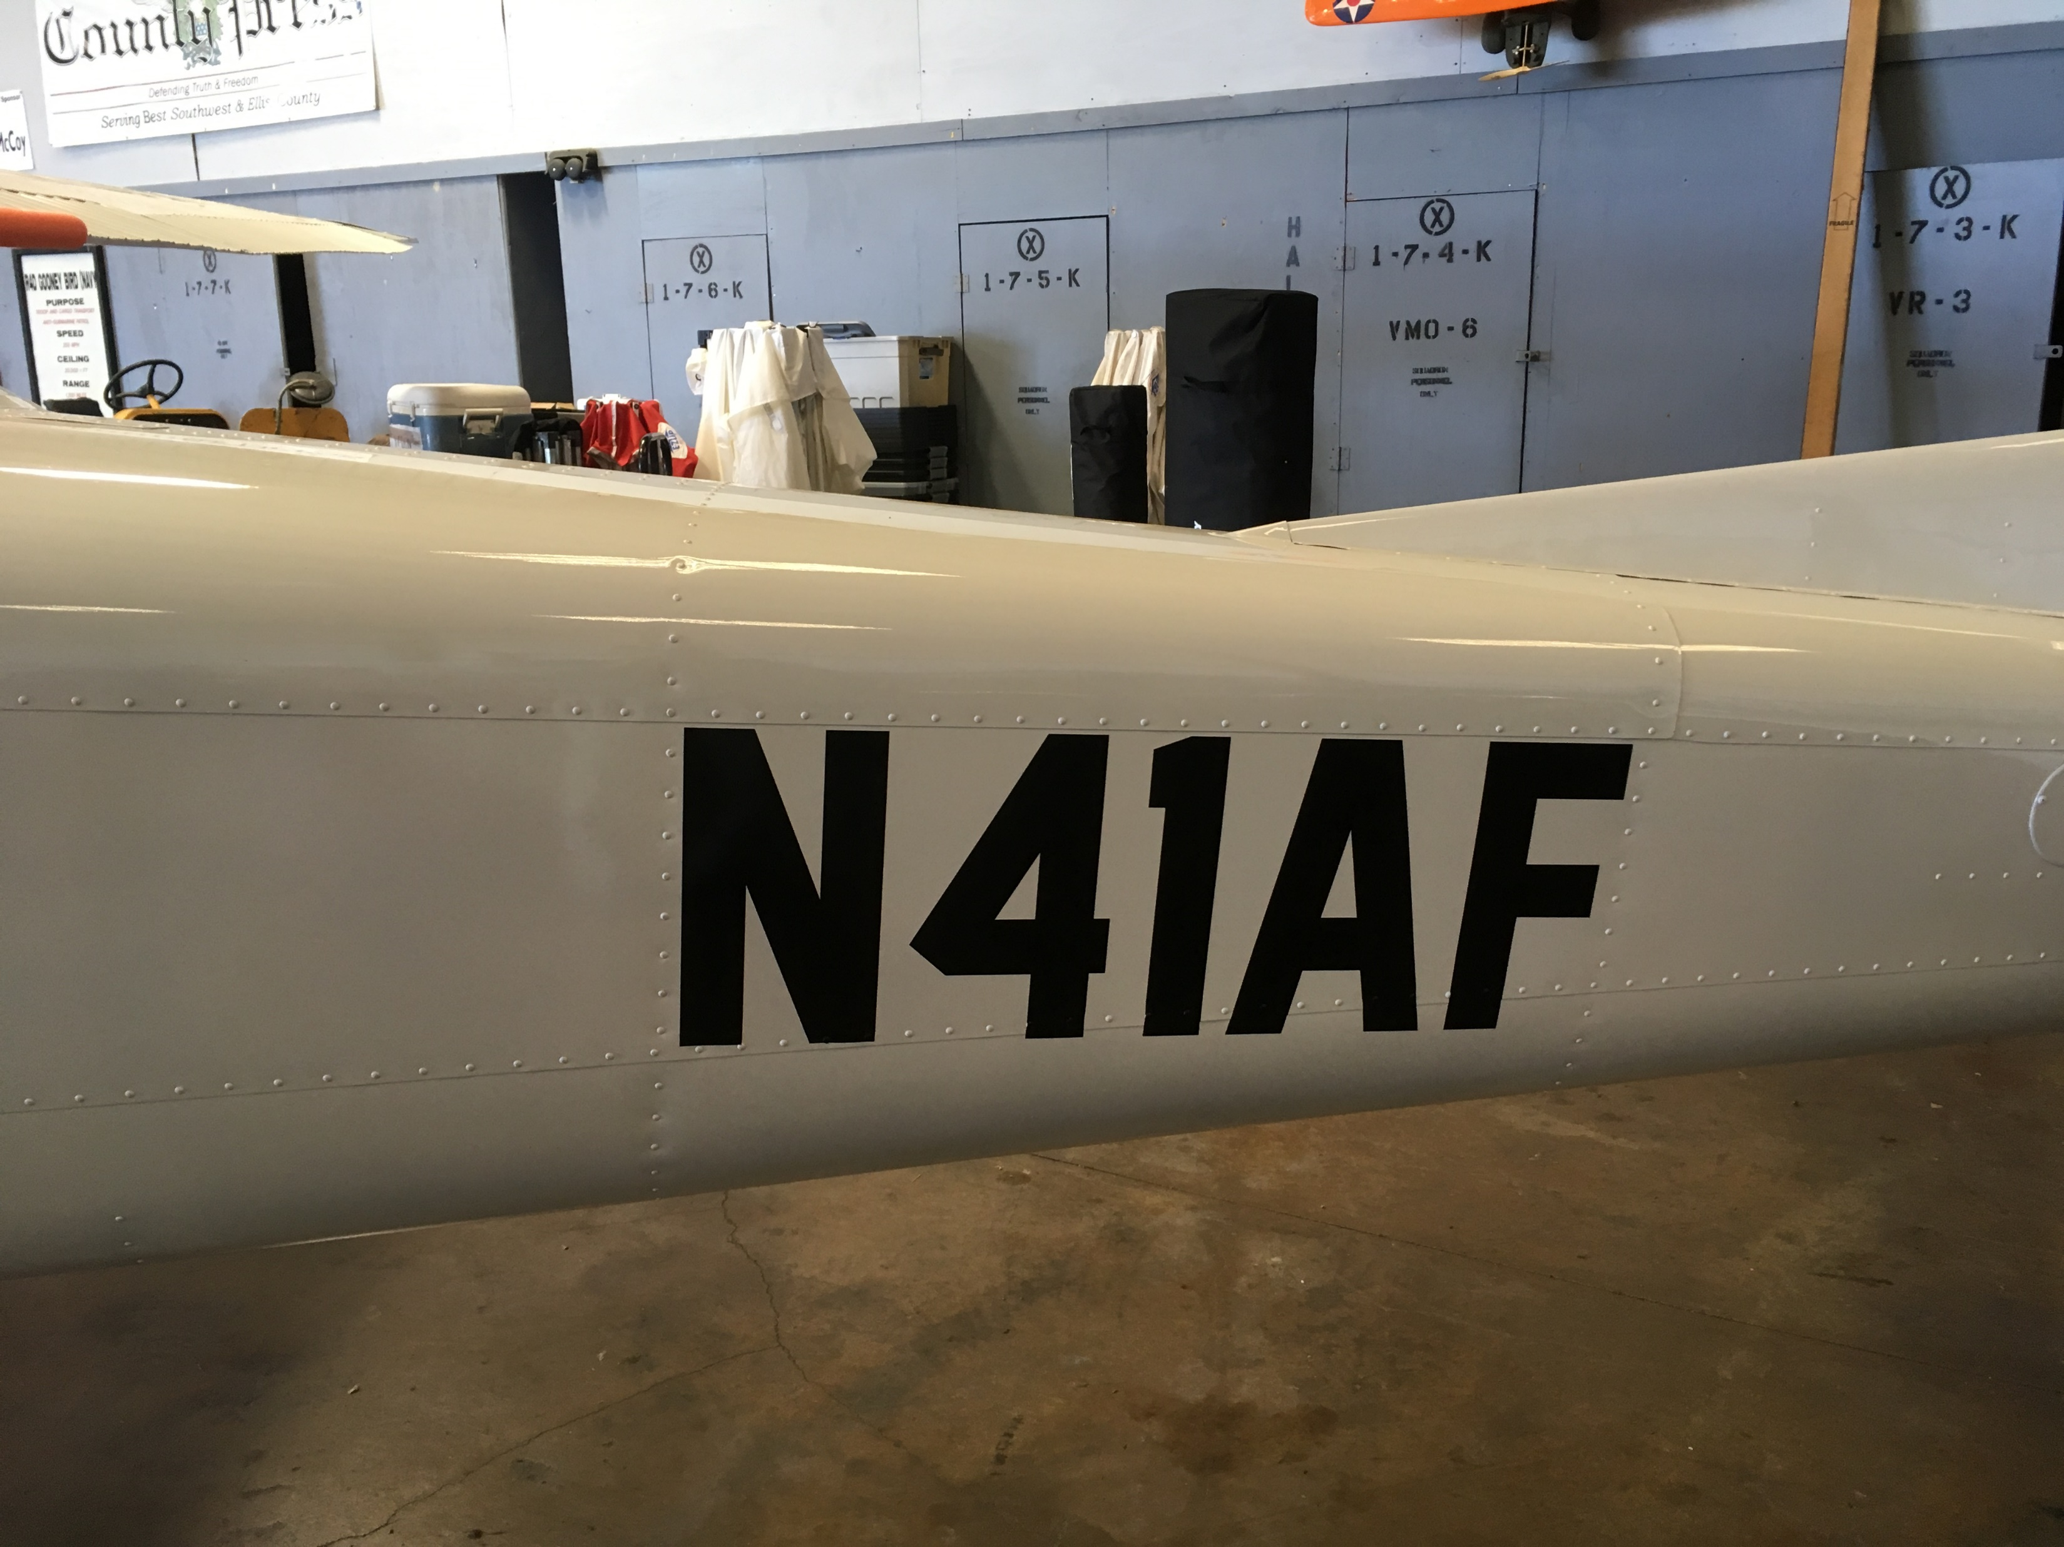
Emergency Extraction Information for Aircraft N 41AF

Slide 2
N41AF
Aircraft Type:T41 (C-172)
Registration:N41AF
Pilot Name:Loren Swanson
Emergency Contact Name:Jim Breitenstine
Emergency Contact Number:817-343-6223
Date:4/28/2019

Slide 3
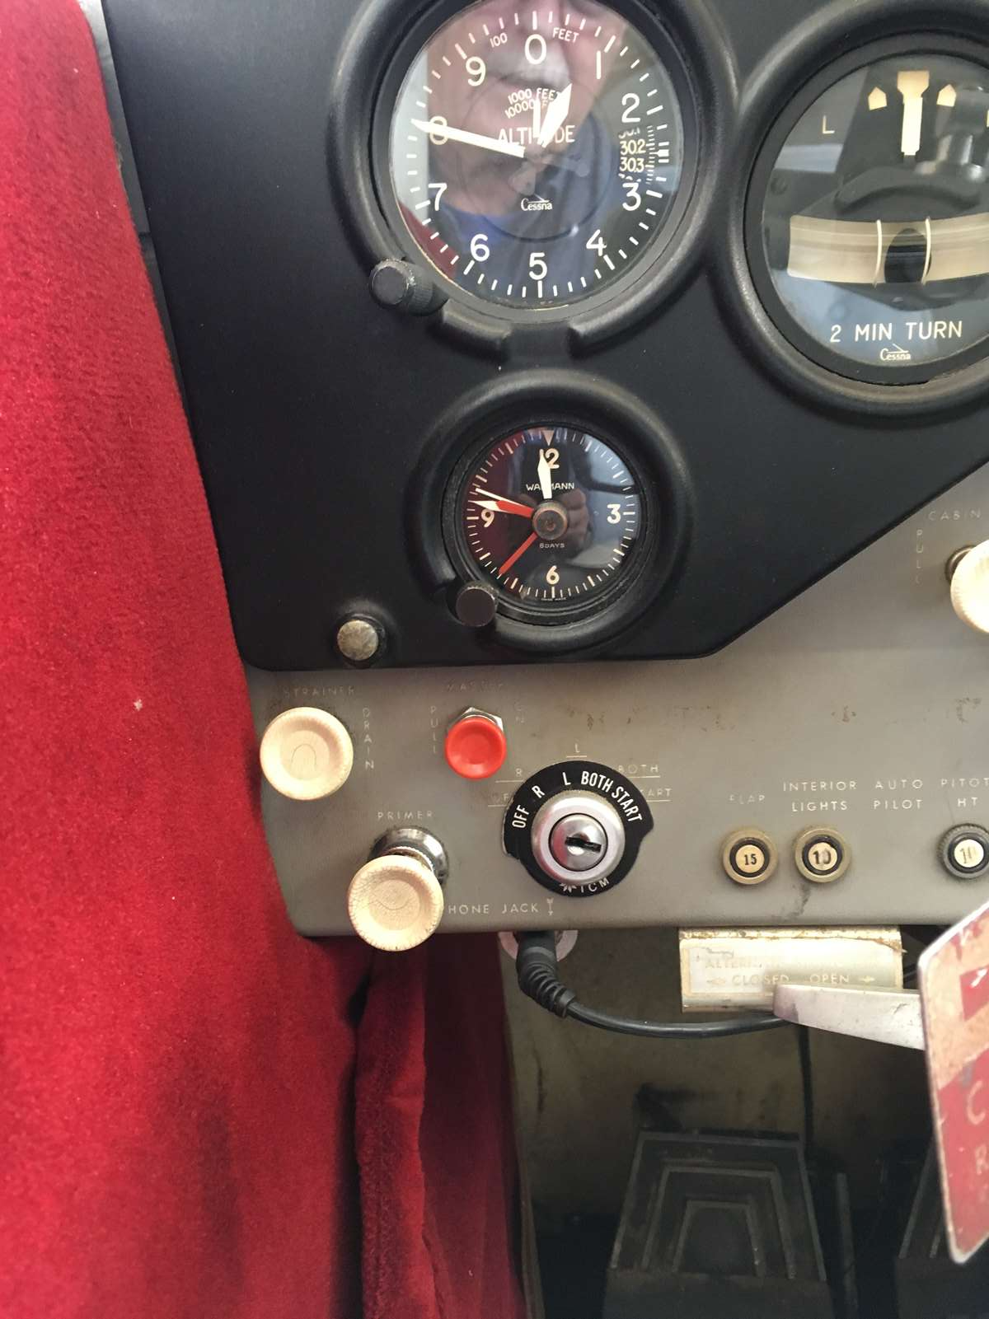
Electrical/Ignition System
N41AF
Master electrical switch (red)
Push off
Magneto switch – key CC off

Slide 4
Harnesses N41AF
Auto style belt
4 passenger max

Slide 5
Hazmat
N41AF
100LL fuel in both wings

Slide 6
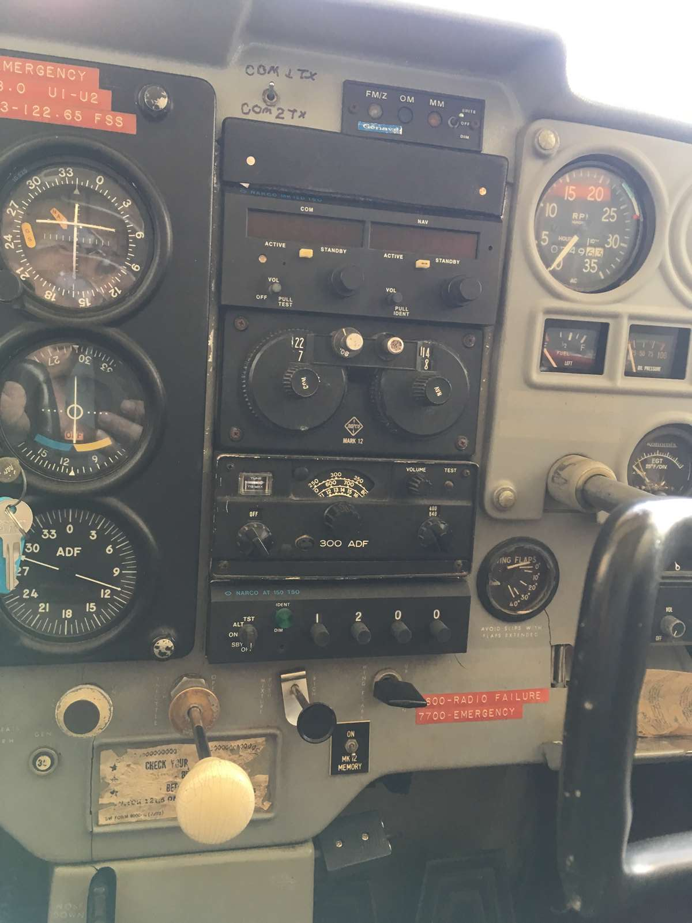
Fuel System N41AF
Main fuel shutoff - lower center
Mixture shutoff center panel

Slide 7
Canopy System N41AF
Doors located on each side of the aircraft

Slide 8
N41AF
Aircraft Type:T41 (C-172)
Registration:N41AF
Pilot Name: Keith Barrett
Emergency Contact Name: Jim Breitenstine
Emergency Contact Number:817-343-6223
Date:9/30/2023

