Slide 1
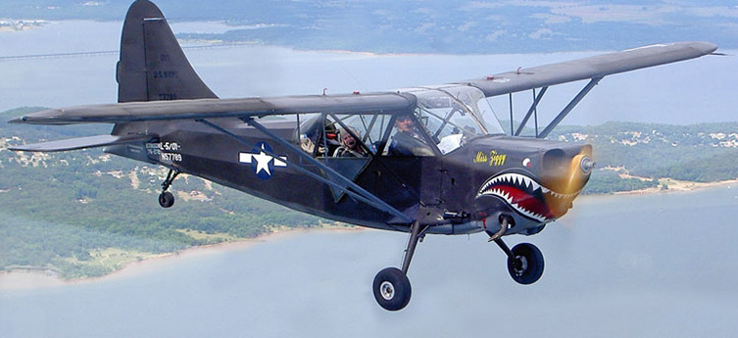
Stinson L-5 (Sentinel)
Miss Ziggy
STANDARD DATA:
Seats 2.
Gross wt. 2050.
Fuel capacity 36 gallons.
Engine 190-hp Lycoming.
PERFORMANCE:
Top mph 130.
Cruise mph 112.
Initial climb rate 975.
Ceiling 15,800.
Range 275.
Maximum range 420.
1
Single Engine Ground

Slide 2
Stinson L-5
Sentinel
Between December 1942 and September 1945 3,590 L-5's were built.
It's primary purpose as a liaison aircraft was courier and communication work, artillery spotting and casualty evacuation.
2
Single Engine Ground

Slide 3
Stinson L-5
Limitations
Takeoff speeds
Flaps Down 51 mph
Flaps Up 57 mph
Takeoff Power
2250, 5 minute max.
Normal Cruise
2200 rpm
Flap Settings ………30⁰ and 45⁰
Stall Speeds
Power OFF Flaps Up…….. 57
Power OFF Flaps Down.… 49
Max Dive Speed……………… 208
Best Glide Speed…………….…70
3
Single Engine Ground

Slide 4
Stinson L-5
Limitations
Maximum Flap Operating Speed……..100 mph
Electrical system is…………………….…. 12 VDC
Minimum and maximum oil…………… 6 / 12 quarts
Maximum Gross Weight………………. 2050 pounds
Maximum Crew Weight……………….. 400 pounds
4
Single Engine Ground

Slide 5
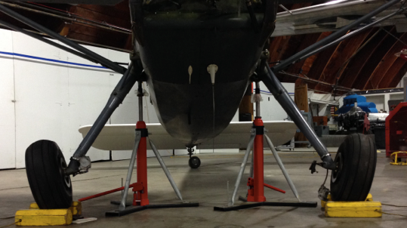
Stinson L-5
Landing Gear
Hardy main gear allows operation from unimproved fields.
Note: Main gear has significant travel. This can result in interesting ground handling if the lateral axis is not aligned.
5
Single Engine Ground

Slide 6
Stinson L-5
Instruments
Airspeed
Altimeter
Ampmeter
Clock
Compass
Oil Pressure
Oil Temperature
Tachometer
6
Single Engine Ground

Slide 7
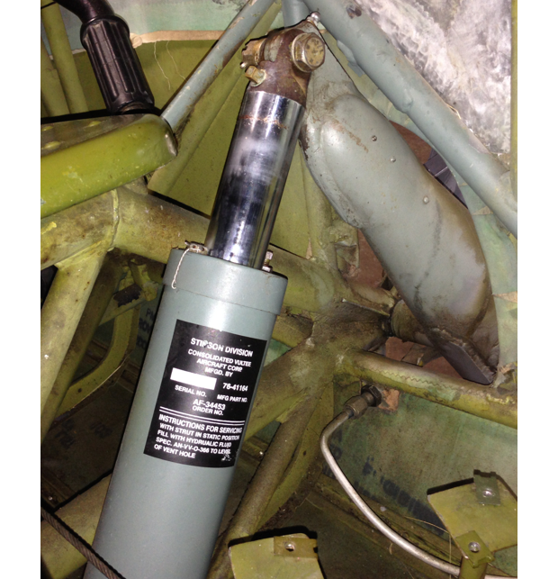
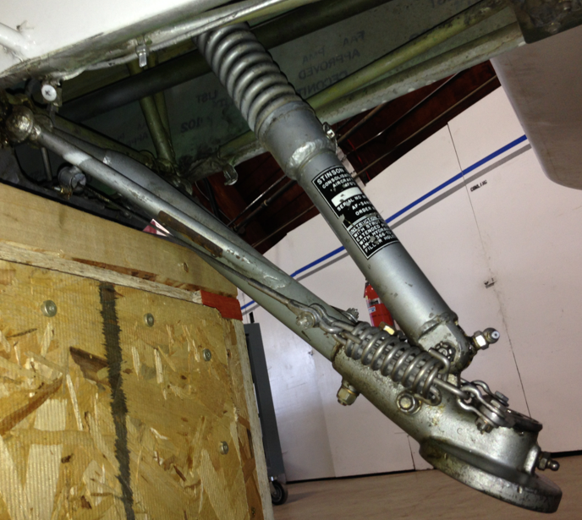
Stinson L-5
Landing Gear
Main gear and tail struts allows operation from unimproved fields.
7
Single Engine Ground

Slide 8
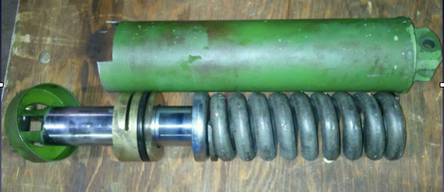
Stinson L-5
Landing Gear
Struts are oleo. Which means they must be properly serviced to function correctly.
8
Single Engine Ground

Slide 9
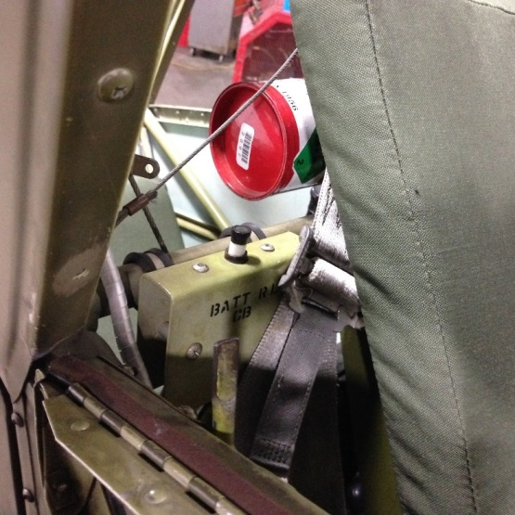
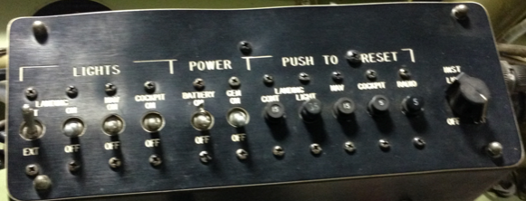
Stinson L-5
Master Switch
The master switch / breaker is located behind the pilots right shoulder.
Generator and battery switches are on the panel on the upper left.
9
Single Engine Ground

Slide 10
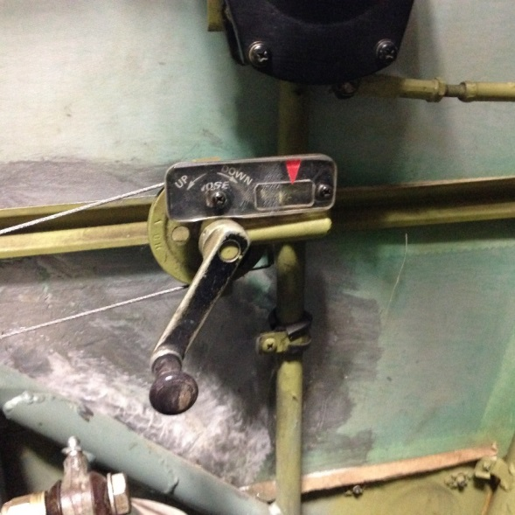
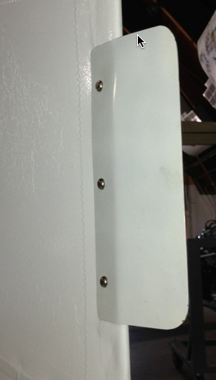
Stinson L-5
Trim
Elevator trim is controlled from the front seat with the trim crank on the left side.
From the rear seat, adjustments can be made by grasping and pulling the trim wires.
Rudder trim is not adjustable from inside the aircraft.
10
Single Engine Ground

Slide 11
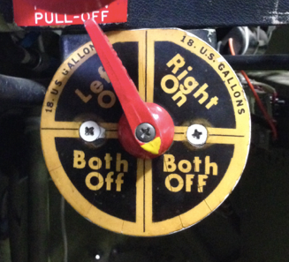
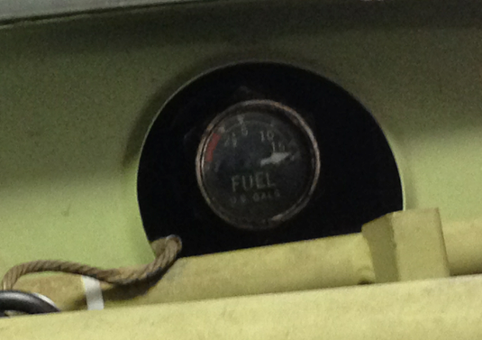
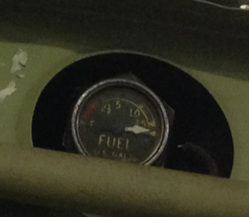
Stinson L-5
Fuel
Fuel capacity is 36 gallons. 18 gallons in each wing tank.
Fuel is gravity feed. Tank selection is via the tank selection switch. Selections are Left, Right, Both Off, Both Off.
Simultaneously feeding from
both tanks is not available.
Fuel quantity gauges are located near the wing spars.
11
Single Engine Ground

Slide 12
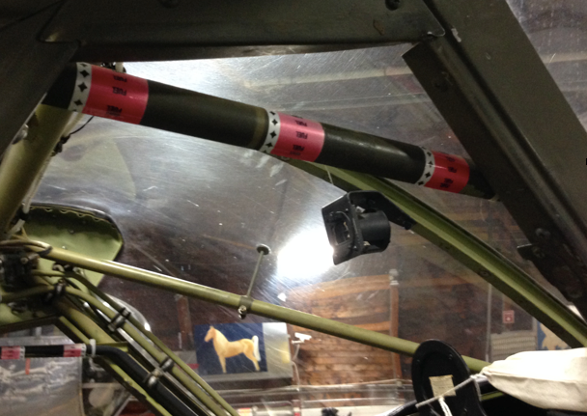
Stinson L-5
Fuel Feed
Fuel is fed from the tanks to the fuel selector via tubing which angles through the cockpit.
The one on the right is often mistaken for a part of the aircraft structural tubing. It is not! And should not be used as a hand hold.
12
Single Engine Ground

Slide 13
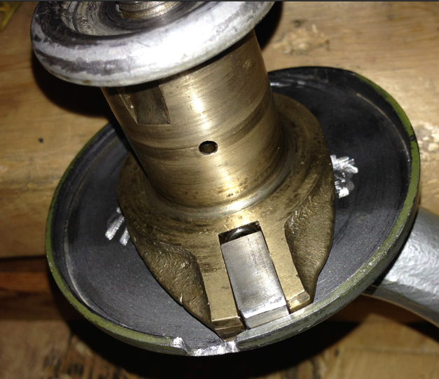
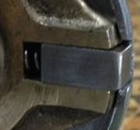
Stinson L-5
Tail Wheel
The L-5 is equipped with a steerable tailwheel. The wheel will become free-castering when sufficient pressure is put on the locking pin to force it out of the detent.
13
Single Engine Ground

Slide 14
Stinson L-5
System / Performance Questions
What is the fuel capacity?
What is the reserve fuel? Which tank?
What is the maximum flap extension speed?
What are the flap settings?
Which parking brake setting is OFF?
36 gallons
Trick question… None
100 MPH
30º, 45º
Right
14
Single Engine Ground

Slide 15
Stinson L-5
System / Performance Questions
What speed is Best Glide?
What the maximum crosswind speed?
What voltage is the electrical system?
What is the minimum oil?
Maximum gross weight is? Max crew weight?
70 mph
~15 knots, not published
12 VDC
6 quarts
2050 / 400
15
Single Engine Ground

