Slide 1
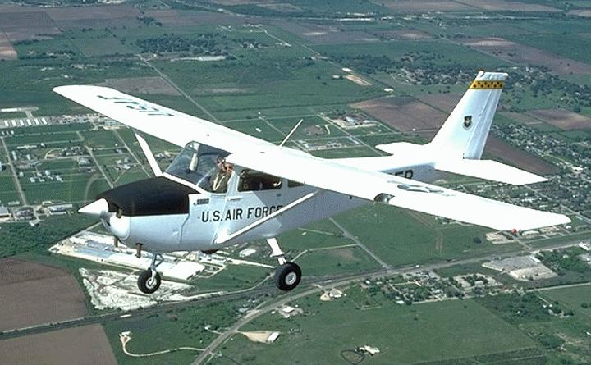
T-41A Ground School
DFW Wing CAF

Slide 2
T-41A BACKGROUND
The Cessna 172 first flew in 1955 and is still produced today. Total production is about 40,000, the most built aircraft of all time.
In the early 60's , the USAF was using an all jet training approach. However, the wash out rate of unsuitable pilots was too costly. Bids were requested for an “off the line” civilian aircraft. Cessna won the contract using a production C-172. Later versions were modified with bigger engines for the Air Force Academy and other services. These will not be covered here.

Slide 3
Our DFW wing T-41A “Mescalero” started life as a 1965 172F. It did not see military action and is actually a T 41 clone. (Just between us) It is the CAF’s first, and so far, only T-41A.

Slide 4
What is the difference between a 172F and the first T 41s ?
________________ ( one word)

Slide 5
Nothing – they are the same

Slide 6
COCKPIT LAYOUT

Slide 7
AIRCRAFT DESCRIPTION
Cessna N41AF is flown in the normal category and therefore is prevented from aerobatic maneuvers including spins.
Operational Data
Max gross wt - 2300 lbs
Empty wt - 1422 lbs - Useful load - 878 pounds
Fuel cap - 39 gals
Oil cap - 8 qts. ( 6 qts min at take off. Do not fill above 7 qts. )
Stall speed - Power off 0 flaps - 57 mph
40 flaps - 49 mph

Slide 8
What is the full fuel usable load of N41AF?
______________ Pounds

Slide 9
878 pounds

Slide 10
What is the max allowable Weight?

Slide 11
2300 pounds

Slide 12
What is the fuel capacity?

Slide 13
39 Gallons

Slide 14
What is the oil capacity?

Slide 15
8 qts.

Slide 16
What is the minimum oil quantity for flight?

Slide 17
6 Qts.

Slide 18
How many quarts of oil for normal flights?

Slide 19
7 Qts.

Slide 20
How many Qts of oil for cross country flight?

Slide 21
8 Qts.

Slide 22
Are Spins Authorized?

Slide 23
No!

Slide 24
Are Aerobatics authorized?

Slide 25
No!

Slide 26
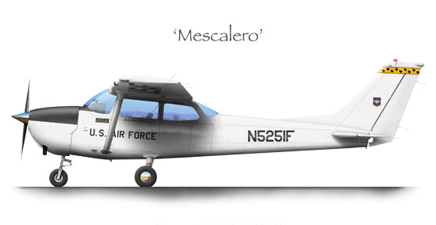
OPERATION
Approach speeds between 60 and 80 are best. Don't go below about 70 unless flaps are full.
Above 80 just burns runway and YOUR tires.

Slide 27
What is the best approach speed

Slide 28
Approach speeds between 60 and 80

Slide 29
OPERATION
Flaps at 0 is best for all but short field take offs. Lift the nose wheel at 60 MPH and let it fly off.
85 MPH is best rate - Vy
65 is best angle - Vx

Slide 30
What is Vx speed

Slide 31
65 is best angle - Vx

Slide 32
What is the Vy speed

Slide 33
85 MPH is best rate - Vy

Slide 34
EMERGENCY PROCEDURES
The 1965 POH does not have emergency procedures!! Some common sense items in case of engine failure would be;
Carb heat to full on
Mixture full rich
Slow to 80 MPH for best glide.
Switch tanks. If on both, switch to the fullest tank for 60 seconds and then to the other tank. This is for vapor accumulation reasons.
Aviate / navigate / communicate. Don't panic. Glider pilots do this for every landing.
Many people try to stretch the glide and stall. If you don't like the spot you are going to hit, maintain airspeed, keep the wings level, avoid obstacles and dissipate energy.

Slide 35
What emergency procedures are listed in the POH for the 1965 C172

Slide 36
NONE

Slide 37
What is the best glide speed?

Slide 38
80 MPH

Slide 39
ENGINE INSTRUMENTS

Slide 40
ADDITIONAL INFO
Fuel sump drain is below the fuel filter. Drain control in cockpit is disconnected.
Flaps in 1965 were allowed to 40 degrees. Newer 172s are limited to 30.
Do not use full flaps in cross winds. Do not slip with flaps over about 20 degrees.
N41AF does not have flap limit switches up or down. You must hold the flap handle until desired position is reached. When the flaps are full up a loud squeal will sound. (You may not hear this with headsets on. )This means let go of the switch. Do not trust the flap position indicator.
A good cruise RPM range is about 2200 to 2400 at normal altitudes. Trying to go fast just makes more noise and burns more of your gas.

Slide 41
What is the Max flap setting?

Slide 42
40 degrees

Slide 43
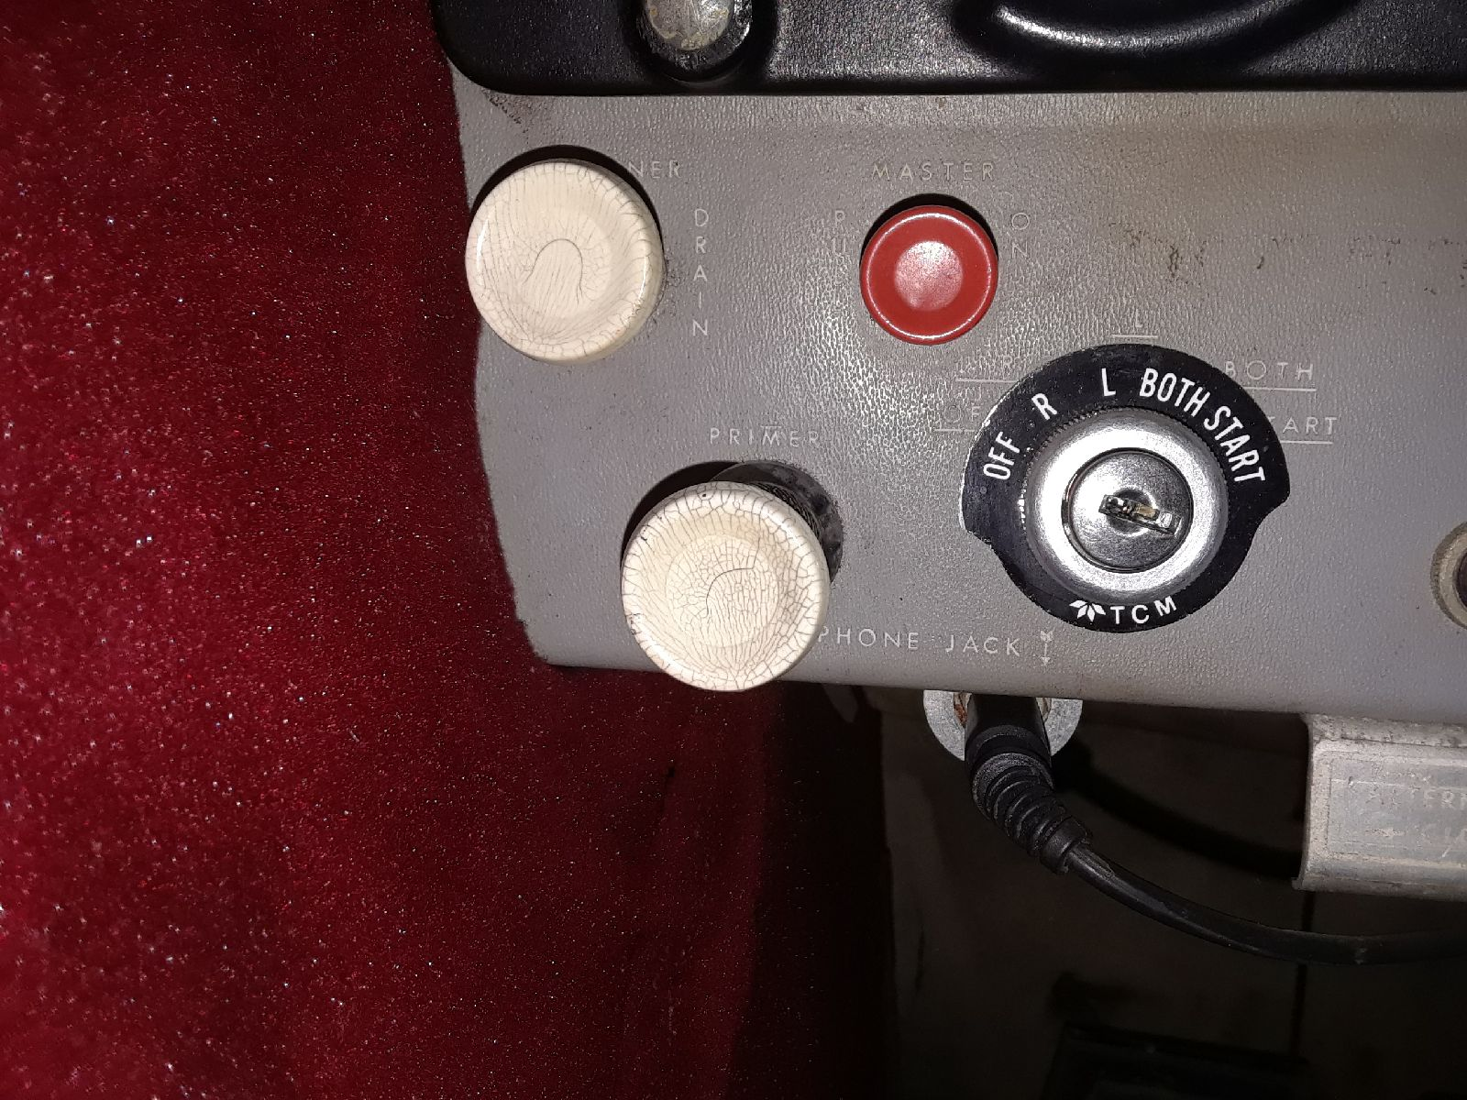
FUEL SUMP IN WHEEL WELL
Inop in cockpit

Slide 44
Where is the fuel sump drain!

Slide 45
below the fuel filter.

Slide 46
ADDITIONAL INFO CONTINUED
Carburetor heat is NOT mandatory. The POH states “ as required”. Use it
for landings and low power settings or when icing suspected.
The cabin air knob is backwards. All other controls are normally IN. Cabin air is OUT for fresh air.
Never push on the horizontal stabilizer when moving the aircraft.
The aircraft airworthiness certificate and registration is in the pocket by the
pilots left foot. Weight and balance info is in the pilots seat back. The flight log
is also in the seat back. Fill out both logs after every flight.

Slide 47
When should you use Carb heat?

Slide 48
landings and low power settings or when icing suspected

Slide 49
COMM PANEL ON FLOOR

Slide 50
Radio Operation.
41AF has two working NavComs but not much else The top radio is a Narco Mk 12D.
It works well but the freq indicator is mostly unreadable. Set the desired freq in the standby window and then switch freqs. Try to remember what you selected or switch back. The VOR works but seems weak. They will be decommissioned soon anyway. There is an ILS but I have never tested it or the Marker Beacon

Slide 51
The second radio is a Narco Mk 12. believe it or not, it is a tube radio.
Give it about 30 seconds to warm up. It is a 360 channel radio. You can't select .xx5 frequencies such as LNC ATIS. ( 118.975).
A radio upgrade is in the hoping stage so all of this will be obsolete some day.

Slide 52
There are two small add on toggle switches on the panel. The one left of the marker beacon determines which radio you are transmitting.
Up (COM 1 TX) selects the top radio and down the other. This switch does not effect receiving.
If both radios are on with the volume up you will hear both radios.
The other toggle switch low on the panel turns on MK12 memory. Set to ON will store the last COM and NAV freqs when the MK 12D was turned off.

Slide 53
The ADS B Out was installed. It is a tail beacon. This means that you MUST have the NAV lights on at all times.
Get in the habit of turning on the nav lights, the beacon light and transponder soon after start up.
There is no avionics master.

Slide 54
What needs to be on to power the ADSB?

Slide 55
The Nav lights

Slide 56
The intercom is a four place add-on unit. The push to talk switch is on the pilots yoke. The worst part of this is the radio/intercom switch on the floor mounted box. You must be in radio mode to transmit, but then so you can't hear the passengers.
I like that part but you have remember to switch it back to intercom. I think this is so the petrified passengers can't yell at the tower.
The ADF and DME are inop.

Slide 57
Flight requirements.
Before every flight you must notify the Ops officer your intention. Currently a text message to Fred is sufficient. After the flight you must fill the tanks and fill out the log.
Always check Rallye Point to confirm that the aircraft and pilot are legal to fly
A weight and balance needs to be done and emailed to the Wing
Condirm that there will be D&A forms available for the flight
Fill out a hold harmless for all passengers

Slide 58
Should a weight and balance need to be done for every flight?

Slide 59
Yes

Slide 61
What is the allowble baggage weight?

Slide 62
120 pounds

Slide 64
What is the wingspan of the T41A?

Slide 65
36 feet 2 inches

Slide 67
What are the nose and main wheel tire pressures?

Slide 68
Nose Wheel – 26 psi
Main Wheels - 24 psi

Slide 69
Fly into,
Dive away from
the wind

Slide 70
What are the proper ground wind control positions?

Slide 71
Fly into,
Dive away from
the wind

Slide 73
What RPM is used for the runup?

Slide 74
1600 RPM

Slide 75
What is the Mag check differential?

Slide 76
Not to exceed 75 RPM

Slide 77
What Flaps are used for normal takeoff?

Slide 78
0 degrees

Slide 79
What is rotation speed?

Slide 80
60 MPH

Slide 82
What is normal climb speed?

Slide 83
80 to 90 MPH

Slide 85
The fuel selector is always set to ________?

Slide 86
Both

Slide 87
What is the normal pattern speed?

Slide 88
70 to 80 , Flaps up

Slide 89
Do not lower flaps above what speed.

Slide 90
100 MPH

Slide 91
What is final approach speed?

Slide 92
65 to 75 Flaps down

Slide 93
1. 1405.55…..52.2
2. 15……………-0.3
3. 340………….12.2
216……..….10.4
160…………11.2
65……………..6.2
______________-
2251.55… 91.9

Slide 96
With the following load is the plane W&B legal?
36 Gallons of Fuel
Full oil
Front seat 340 pounds
Back seat 160 pounds
Cargo 65 pounds

Slide 97
Yes!
1. 1405.55….52.2
2. 15……………-0.3
3. 340………….12.2
216……….10.4
160…………11,2
65……………..6.2
______________-
2251.55… 91.9

Slide 99
Level flight stall speed with flaps up and flaps at 40 degrees?

Slide 100
Flaps up – 57mph
Flaps 40 - 49

Slide 102
What is Take Off Distance at 59 degrees and SL for
2300 pounds – IAS at 50 feet 70 mph – zero wind
1. Normal
2. With 50-foot obstacle

Slide 103
Normal ground run – 865 feet
Obstacle – 1525 feet

Slide 104
What is the rate of climb and fuel used to 5000 feet from SL?

Slide 105
645 feet per minute
2.6 gallons used

Slide 107
At 5000 feet, what is the GPH for
RPM 2400 – BHP 62 – IAS 118

Slide 108
7.1 GPH

Slide 109
From the previous question, what is the endurance and range>

Slide 110
Endurance - 5.1 hours
Range 600 miles (no reserve)

Slide 111
T41 Transition requirements
Private license
100 flight hours
Sponsorship fee $500
Flight evaluation board
Transition letter

Slide 112
How many hours does a pilot need to get a transition letter?

Slide 113
100

Slide 114
What is a Mescalero?

Slide 115
a member of an Apache people of New Mexico.
a member of an Apache people of New Mexico.

Slide 116
GROUND SCHOOL FINISHED
After completion of this online course, contact the Operations Officer to receive credit for your annual review. Place quiz in pilot folder,
Fly Safe!

